Slide 1

HADA ANTIDOPING E-BOOK

Slide 2
contents
1. INTRODUCTION TO ANTI-DOPING
2. Anti-doping rule violations
3. athletes’ RIGHTS and responsibilities
4. the role of the coach/trainer
5. Risks of supplements use
6. Testing procedure
7. Doping control and registered testing pool (adams system)
8. Athlete biological passport
9. health, psychological and social consequences
10. prohibited list / tue
11. the role of the investigation and information office
12. Values based education / case studies
! On this slide you can see hyperlinks assigned for each chapter of the presentation. In order to be able to employ these hyperlinks and have an easier way around this rather large ppt, you must first enter the “presentation” mode, which is located in the bottom right corner with a grail (wine glass) icon.

Slide 3
INTRODUCTION TO ANTI-DOPING

Slide 4


ANTIDOPING SYSTEM
Athletes
Athlete Supporting Personnel
World Anti-Doping Agency
Police / Law Enforcement
National Anti-doping Agencies (HADA)
Court of Arbitration for Sport (CAS)
International Federations (FIFA-UEFA)
Laboratories
Independent Private Testing Agencies (e.g. ΙΤΑ)
National Federations
Major Event Organizations (I.O.C.)
National Olympic Committee

Slide 5









ANTI-DOPING SYSTEM
IF and NADO
Anti-Doping
Rules
International Standards

Slide 6






WORLD ANTI-DOPING AGENCY (WADA)
Athletes
WADA
ASP
CAS
NADOs
Law
Enforcement
IFs
Labs
ITA
MEOs
NFs
International legislator
Responsible for the harmonization/compliance of all antidoping rules in every country
Oversees and coordinates the international battle against doping
Oversees the compliance on international standards and the prohibited list by all the organizations
Recommends politics and gives sanctions in cases of non-compliance
Responsible for the accreditation of Doping Control Laboratories
NOCs
.

Slide 7
NATIONAL ANTI-DOPING ORGANIZATIONS (HADA IN GREECE)
Athletes
ASP
WADA
CAS
NADOs
Law
Enforcement
IFs
Labs
ITA
MEOs
NFs
NOCs
Responsible for following and enforcing the antidoping rules on National level
They have the obligation to act independently of governments and national federations
Responsible for the testing and sanctioning on National level
Responsible for organizing educational programs and activities and bringing them to life
Responsible for collaborating and coordinating with WADA, International Federations and other NADOs
.

Slide 8
INTERNATIONAL FEDERATIONS (IFs)
Athletes
WADA
ASP
CAS
NADOs
Law
Enforcement
IFs
Labs
ITA
MEOs
NFs
NOCs
Responsible for following and enforcing the antidoping rules on International level
Responsible for the testing, educating and sanctioning, in case of ADRVs, the International level athletes
Responsible for collaborating and coordinating with WADA and NADOs
.

Slide 9
NADOs Vs IFs
Athletes
WADA
ASP
CAS
NADOs
Law
Enforcement
IFs
Labs
ITA
MEOs
NFs
NOCs
National Anti-doping Agencies
International Federations
Focus on all sports in one country
They have the testing jurisdiction on RTP athletes whether they train and compete in Greece or not
They bear the right to conduct doping controls on foreign athletes who compete in Greece
Focus on one sport in all countries
Focus on conducting doping controls on International athletes
.

Slide 10

NADOs Vs IFs
Athletes
WADA
ASP
CAS
NADOs
Law
Enforcement
IFs
Labs
ITA
MEOs
NFs
NOCs
An athlete can be doping controlled by both the NADO and the IF of his sport at the same period
The athlete can attend education programs and activities of both
An athlete can be a part of an RTP list of only one of them. He/she cannot be registered in the RTP of both the NADO and the IF of his sport
.

Slide 11
INDEPENDENT PRIVATE TESTING AGENCIES (E.G., INTERNATIONAL TESTING AGENCY)
Athletes
WADA
ASP
CAS
NADOs
Law
Enforcement
IFs
Labs
ITA
MEOs
NFs
NOCs
Independent organizations who offer anti-doping services to National Federations, in International Events
Responsible to organize anti-doping programs for International Federations, in International events
Manage anti-doping subjects such as:
Conducting tests, Results management, Information management, Education
.

Slide 12
WORLD ANTI-DOPING AGENCY
Vs
INDEPENDENT PRIVATE TESTING AGENCIES
Athletes
WADA
ASP
CAS
NADOs
Law
Enforcement
IFs
Labs
ITA
MEOs
NFs
NOCs
WADA is the International legislator in the Anti-doping scenery
WADA does not get involved in the operating procedures of the IPTAs
IPTAs are monitored by WADA
IPTAs are implementation organs for the International Federations and the MEOs
.

Slide 13


MAJOR EVENT ORGANIZATIONS (MEOs)
Athletes
WADA
ASP
CAS
NADOs
Law
Enforcement
IFs
Labs
ITA
MEOs
NFs
NOCs
International Olympic Committee (IOC) and International Paralympic Committee (IPC) are considered MEOs
MEOs schedule and implement anti-doping programs for specific events
Responsible for managing and conducting anti-doping programs in compliance with the Code
IOC: representatives schedule and deliver the anti-doping program to Independent Testing Agencies, for them to implement it in Olympic games or Youth Olympic Games
.

Slide 14

National Olympic and paralympic committees (NOCs and NPCs)
Athletes
WADA
ASP
CAS
NADOs
Law
Enforcement
IFs
Labs
ITA
MEOs
NFs
NOCs
Support the delivery of antidoping programs
The mediator between the athlete and the NADO
They educate the athletes regarding their antidoping responsibilities
They provide information to NADOs which facilitates them in conducting antidoping programs
.

Slide 15

NATIONAL FEDERATIONS (NFS)
Athletes
WADA
ASP
CAS
NADOs
Law
Enforcement
IFs
Labs
ITA
MEOs
NFs
NOCs
Their primary role is to support the implementation of antidoping programs
Informing athletes about their whereabouts responsibilities
Providing education pertinent to antidoping subjects in close collaboration with NADOs
.

Slide 16

WADA-ACCREDITED LABORATORIES
Athletes
WADA
ASP
CAS
NADOs
Law
Enforcement
IFs
Labs
ITA
MEOs
NFs
NOCs
They follow procedures and analyze samples which NADOs provide them
The sample analyzing takes place in compliance with the international standards
They conduct the analyzing of the B sample (if necessary)
.

Slide 17

POLICE AUTHORITIES AND GOVERNMENTS
Athletes
WADA
ASP
CAS
NADOs
Law
Enforcement
IFs
Labs
ITA
MEOs
NFs
NOCs
They support the implementation of antidoping programs
They disclose doping related information
They abide by the legal procedures regarding ADRVs and violations of the WADA Code
.

Slide 18

COURT OF ARBITRATION FOR SPORT (CAS)
They abide by the legal procedures regarding ADRVs and violations of the WADA
Athletes
WADA
ASP
CAS
NADOs
Law
Enforcement
IFs
Labs
ITA
MEOs
NFs
NOCs
Resolves sport related legal disputes amongst confronting opposite sides
Represents the sport supreme court and the mediator in sport related legal cases
Is responsible for ADRVs definition related cases
Conducts hearings and impartially decides and enforces sanctions
.

Slide 19

ATHLETE SUPPORT PERSONNEL (ASP)
Athletes
WADA
ASP
CAS
NADOs
Law
Enforcement
IFs
Labs
ITA
MEOs
NFs
NOCs
Support the athletes during the doping control procedure
Represent/chaperone the athlete during the testing procedure
Must be updated about the antidoping procedures as well as for their athletes and their own rights and responsibilities
Must inform their athletes about the principles and values of antidoping culture
.

Slide 20

ATHLETES
Athletes
WADA
ASP
CAS
NADOs
Law
Enforcement
IFs
Labs
ITA
MEOs
NFs
NOCs
The most crucial links in the antidoping system
Subjects of the antidoping rules
Responsible to be fully aware of their rights and responsibilities
Obligated to follow the protocol of the sample collection/doping control procedure
.

Slide 21
End of 1st chapter
Back to the contents

Slide 22


ADRVs

Slide 23

ADRVs
1. Presence of a prohibited substance or its metabolites or markers in an athlete’s sample
Athletes are responsible for any prohibited substance or its metabolites or markers in their samples.
2. Use or attempted use of a prohibited substance or prohibited method:
The success or failure of the use or attempted use of a prohibited substance or prohibited method does not constitute a valid/submittable clue.
3. Evading, refusing or failing to submit to sample collection:
Without complete justification, after being notified by the DCO or another authorized person.
4. Whereabouts failures -three strike rule:
Combination of three missed tests or/and failed update of their whereabouts information in a 12-month timeframe for the athletes who are part of the RTP.
5. Tampering or attempted tampering of every part of the antidoping testing procedure from the athlete or another person.

Slide 24
ADRVs
6. Possession of prohibited substances and prohibited methods for athletes and ASP:
Except for the case of a granted TUE related substance.
7.Trafficking or attempted trafficking of prohibited substances and prohibited methods from athletes, ASP and others.
8. Administration or attempted administration of prohibited substances and prohibited methods from an athlete, ASP or non-participant to an athlete.
9. Complicity or attempted complicity from an athlete or another person:
Assisting, encouraging, aiding, abetting, conspiring, covering up or any other type of intentional complicity, involving any ADRV or attempted ADRV

Slide 25
ADRVs
10. Prohibited association:
This ADRV can be based only on solid grounds. The NADO must prove that the non sanctioned party was aware that the associated party was under a sanction. Respectively, the party under scrutiny in such a case is obligated to prove that the association with the sanctioned party was not of a professional or an athletic nature or/and was unavoidable.
11. Acts by an athlete or other person to discourage or retaliate against reporting to authorities:
Any action which threatens or intimidates another person with the intention to discourage him/her from reporting any kind of information regarding an ADRV.
Any kind of retaliation against anyone who has provided valuable intel, clues, evidence regarding an ADRV.

Slide 26
SANCTIONS
In an event where an ADRV is committed any kind of accomplishment gets disqualified.
(2.1, 2.2, 2.6: presence, use, possession of prohibited substances)
Ineligibility period: 4 years
In case of an ADRV with a non-specified substance or method (4years), except for the case when the person under scrutiny proves the ADRV was unintentional (2years).
In case of an ADRV with a specified substance or method (2 years), except for the case when the NADO proves that the ADRV was intentional (4years).
If the prerequisites for 4 years do not stand, then the ineligibility period lasts 2 years

Slide 27
If the athlete can prove that the use took place out of competition and was unrelated to his/her athletic performance, then the ineligibility period is 3 months
Substances of abuse
Sanction due to other ADRVs
ADRVs for article 2.3 (evading/refusing) or 2.5 (tampering) the ineligibility period is 4 years

Slide 28
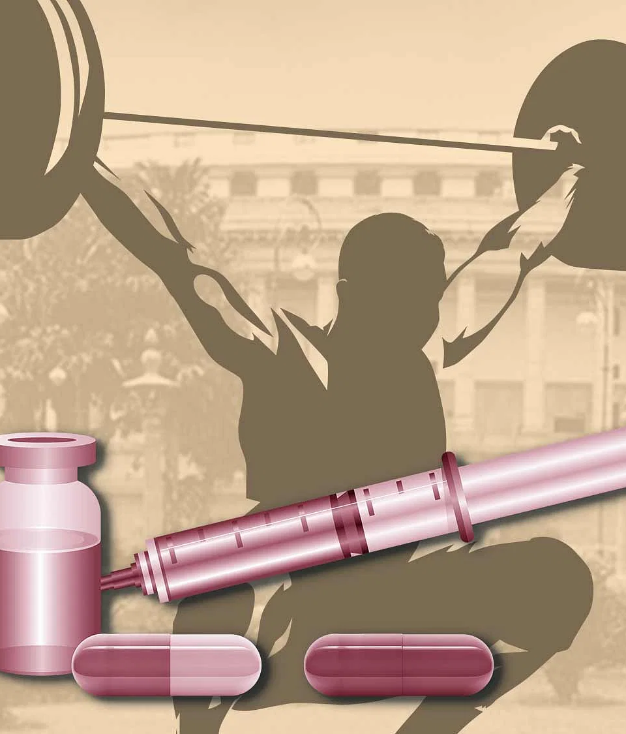
SANCTIONS CONTINGENT UPON ADRVs
2.4 (whereabouts)
The ineligibility period is 2 years, with possible reduction to at least one year, depending on the fault significance of the person under scrutiny.
2.7 (trafficking) ή 2.8 (administration)
The ineligibility period fluctuates between at least 4 years up to ban for life depending on the seriousness of the ADRV.
2.9 (complicity)
The ineligibility period ranges from at least 2 years up to ban for life depending on the seriousness of the ADRV.
2.10 (association)
The ineligibility period is 2 years, with possible reduction to at least one year, depending on the fault significance of the person under scrutiny and other condition around the case.
2.11 (discouragement, retaliation)
The ineligibility period ranges from at least 2 years up to ban for life depending on the seriousness of the ADRV.

Slide 29
The ineligibility period, which is normally designated/enforced, extends up to 2 years, depending on the severity of the ADRV and the nature of the aggravating circumstances
Aggravating circumstances which may extend the sanction period
Elimination of ineligibility period when there is no fault
If an athlete or another person under scrutiny proves in specific cases that there was no fault whatsoever, then the enforced ineligibility period gets completely revoked
In case of an ADRV involving a special reference substance (except for an addiction substance), or special reference method, and the athlete or another person can prove that there was limited liability, then the enforced sanction ranges from a mere reprimand with no ineligibility period (bare minimum), to an ineligibility period of 2 years (maximum), depending on the fault significance of the person under scrutiny.
Reduction of ineligibility period due to nonsignificant fault

Slide 30
In cases when the athlete can concurrently prove that there was not significant fault and that the detected substance came from a contaminated product, the enforced consequence ranges from a mere reprimand with no ineligibility period (bare minimum), to an ineligibility period of 2 years (maximum)
Contaminated products
If in an ADRV case concerning a protected person or non-athletes there is not concurrently an addiction substance and significant fault, then the enforced consequence ranges from a mere reprimand with no ineligibility period (bare minimum), to an ineligibility period of 2 years (maximum)
Protected person and recreational athletes
If an athlete or another person can prove in specific cases, in which the article 10.6.1 does not apply, that he does not bear significant fault, then the article 10.7 defines that the capacity of the enforced ineligibility period can be reduced up to half its initial life, contingent upon the fault significance
Application of limited liability in cases outside f the article10.6.1. spectrum

Slide 31

Revocation, reduction or suspension of the ineligibility period, or other consequences except for fault/negligence significance
Substantial contribution in revealing or proving ADRVs
The enforced ineligibility period can not be suspended for a timeframe bigger than its ¾.

Slide 32
Reduction of one year for specific ADRVs in case of an on-time confession and acceptance of sanction.
RESULT MANAGEMENT DEALS
When an athlete or another person has been notified from the NADO for a possible ADRV which bears an ineligibility period of 4 years or more and he/she comes forward, confesses his wrongdoing and accepts his ineligibility period in a timeframe of max 20 days after he has been notified, he/she has the right to claim a reduction of 1 year out of the initial ineligibility period.
Deal of case resolution with WADA’s approval

Slide 33

Multiple ADRVs
Second violation leads to a bigger ineligibility period
Third violation leads to ban for life

Slide 34
Disqualification of results in any event after an ADRV is found
The NADO has the capability to:
a) recover any expenses related to the ADRV the person under scrutiny has committed (Forfeiture of prize money)
or/and
b) To enforce a fine which could get as high as 10.000 euros
Financial consequences
Inclusion of already served suspension time or ineligibility period
In case the enforced ineligibility period is being served by the sanctioned person then the already served ineligibility period gets included in the summary of the ineligibility period.

Slide 35

Regime during the ineligibility period or the temporary adjourned period
In an ineligibility period or a provisional suspension period, it is prohibited to participate under any role in a game, activity or event which is held and approved by any signatory.
Prohibited participation
Automatic public disclosure of sanction

Slide 36
When a notification of an ADRV has been sent in more than one members of a sports team, the supervising agency/organization of the sport event conducts targeted tests on the team during the ongoing event.
Team sports control
Team consequences
If more than two team members have committed an ADRV during a sport event, the supervising agency/organization enforces the appropriate sanction to the team (e.g. points reduction, game/event cancellation or some other kind of sanction)
Team sports consequences

Slide 37

PENAL SANCTIONS
Article 128Θ LAW 2725/1999
1. Whoever administers natural or chemical or biological or biotechnological material or applies a prohibited method (from the mutual decision/degree of article 128Γ’) to an athlete with the intention to enhance his/her athletic capability, performance, during an athletic event or beforehand, is sanctioned with imprisonment of at least 3 years and with a fine between 25.000-50.000 euros
2. An athlete who uses natural or chemical or biological or biotechnological material or allows the application of a prohibited method (as designated by the mutual agreement of article 128Γ’) to himself/herself with the intention to enhance his/her athletic capability, performance, during an athletic event or beforehand, is sanctioned with imprisonment of at least 2 years
3. In case of the paragraph 1., if the athlete is a minor, the imprisonment sentence gets increased to at least 10 years and a lifetime deprivation of the sports related profession license is also enforced.

Slide 38
4. Whoever manufactures, extracts, saves, traffics, trades, gets supplies, supplies natural or chemical or biological or biotechnological material or applies a prohibited method (from the mutual decision/degree of article 128Γ’) or gets involved in any way on the aforementioned with the intention to enhance his/her athletic capability, performance, during an athletic event or beforehand, gets sanctioned according to paragraph 1., except for the case when such a violation is not sentenced in a more severe manner by another degree. If the accused has proceeded to his wrongdoings inside the sport facilities, with the intention to administer prohibited substances or apply prohibited methods on minors and on minor athletes, the sanctions are similar of the ones in Paragraph 3.
5. Apart from the aforementioned sanctions, an order for the confiscation and destruction of the prohibited substances is ruled.
6. Whoever obstructs the testing authorities in their act of duty gets sanctioned with imprisonment of at least 2 years. Whoever destroys, tampers, or makes the sample use meaningless or forges, falsifies, tampers the results process, gets sanctioned in the same manner. If the aforementioned acts were committed intentionally by a DCO or his assistant, a HADA member, a certified testing lab personnel member, he or she gets an imprisonment sentence of up to 10 years.
7. The amendment of any imprisonment sentence of this article is prohibited, except for the paragraph 2 cases.

Slide 39
End of 2nd Chapter
Back to the Contents

Slide 40

ATHLETES RIGHTS & RESPONSIBILITIES

Slide 41
INTRODUCTION
One of the primary goals of WADA, as stated by the code, is the protection of the foundational athletes right to compete under the same conditions, under the light of health, justice and the right to equal opportunities.
The protection of the athletes right to compete without the presence of doping is imperative for WADA and HADA
It is implied that athletes and ASP share the same vision of keeping the sports integrity intact.

Slide 42
ATHLETES’ RIGTHS
Equal opportunities:
Highest level performance during trainings and games, whilst ensuring the absence of athletes using prohibited substances and methods.
Fair testing programs:
All athletes from all countries are getting doping controlled based on the designated procedures by the code and the International Standards.
Medical attention and health protection:
Right of freedom regarding any kind of pressure associated with health hazards (physical, psychological) pertinent to doping. Right to get a TUE (if they fulfill the requirements).

Slide 43
Right to justice:
Just, unbiased, and operatively independent hearing committee (immediate and justified decision). Right to appeal and to be represented by an attorney.
Right to accountability:
Any organization who has jurisdiction over athletes is accountable for its actions and negligence, whilst it also has the power to report any compliance issue.
Right of informant:
Report any potential ADRV related behavior (anonymously/confidentially).

Slide 44
Right to education:
Antidoping education and information from national and international agencies/organizations.
Right to personal data protection:
Right to just, legal and safe use of personal data, getting informed for any adjustment of their data and requiring their deletion when those do not accommodate or have any use for any antidoping procedure.
Right to compensation:
Every athlete has the right to go after a compensation from other athletes or others who have committed an ADRV (prize, medal etc.)

Slide 45
Rights of protected persons:
The athletes who are designated by the Code as “protected” are further protected compared to the others.
Rights during testing:
DCO Identity
Further information regarding the process
Representative or interpreter
Delay of arrival at doping control station under certain conditions
Update on his/her rights and responsibilities
Copy of the DCF (Doping Control Form)
Right to the B sample analysis:
If the sample A analysis ensues an adverse finding, then the athlete has the right to request for a B sample analysis under his or a representative of his surveillance/presence.

Slide 46
ATHLETES’ RESPONSIBILITIES
To be aware and follow the antidoping rules, policies and practices.
To always be available for a doping control.
To take full credit of accountability for anything they use, consume or gets found inside their bodies (strict liability).
To inform their medical personnel that they cannot use prohibited substances or methods designated in the Prohibited List and Methods. Furthermore, any council or treatment they get, must comply with the rules of the Code and not violate any part of them.
To inform HADA or their IF (International Federation) whether they have committed any ADRV in the last 10 years.
To collaborate with antidoping organizations in antidoping related researches.
To disclose the identification documents of their ASP (Athlete Support Personnel), whenever the antidoping organizations requires them.

Slide 47
RESPONSIBILITIES DURING SAMPLE COLLECTION
To remain under close observation of the DCO (Doping Control Officer) from the initial touchpoint through the completion of the doping control procedure
To present a valid identification document (ID, driver’s license)
To comply with the testing procedure. Fail to do so may constitute an ADRV
To present him/herself immediately for doping control, should he be asked to, except for the case when there is a valid reason for a delay (chapter 7)

Slide 48
End of 3rd chapter
Return to contents

Slide 49

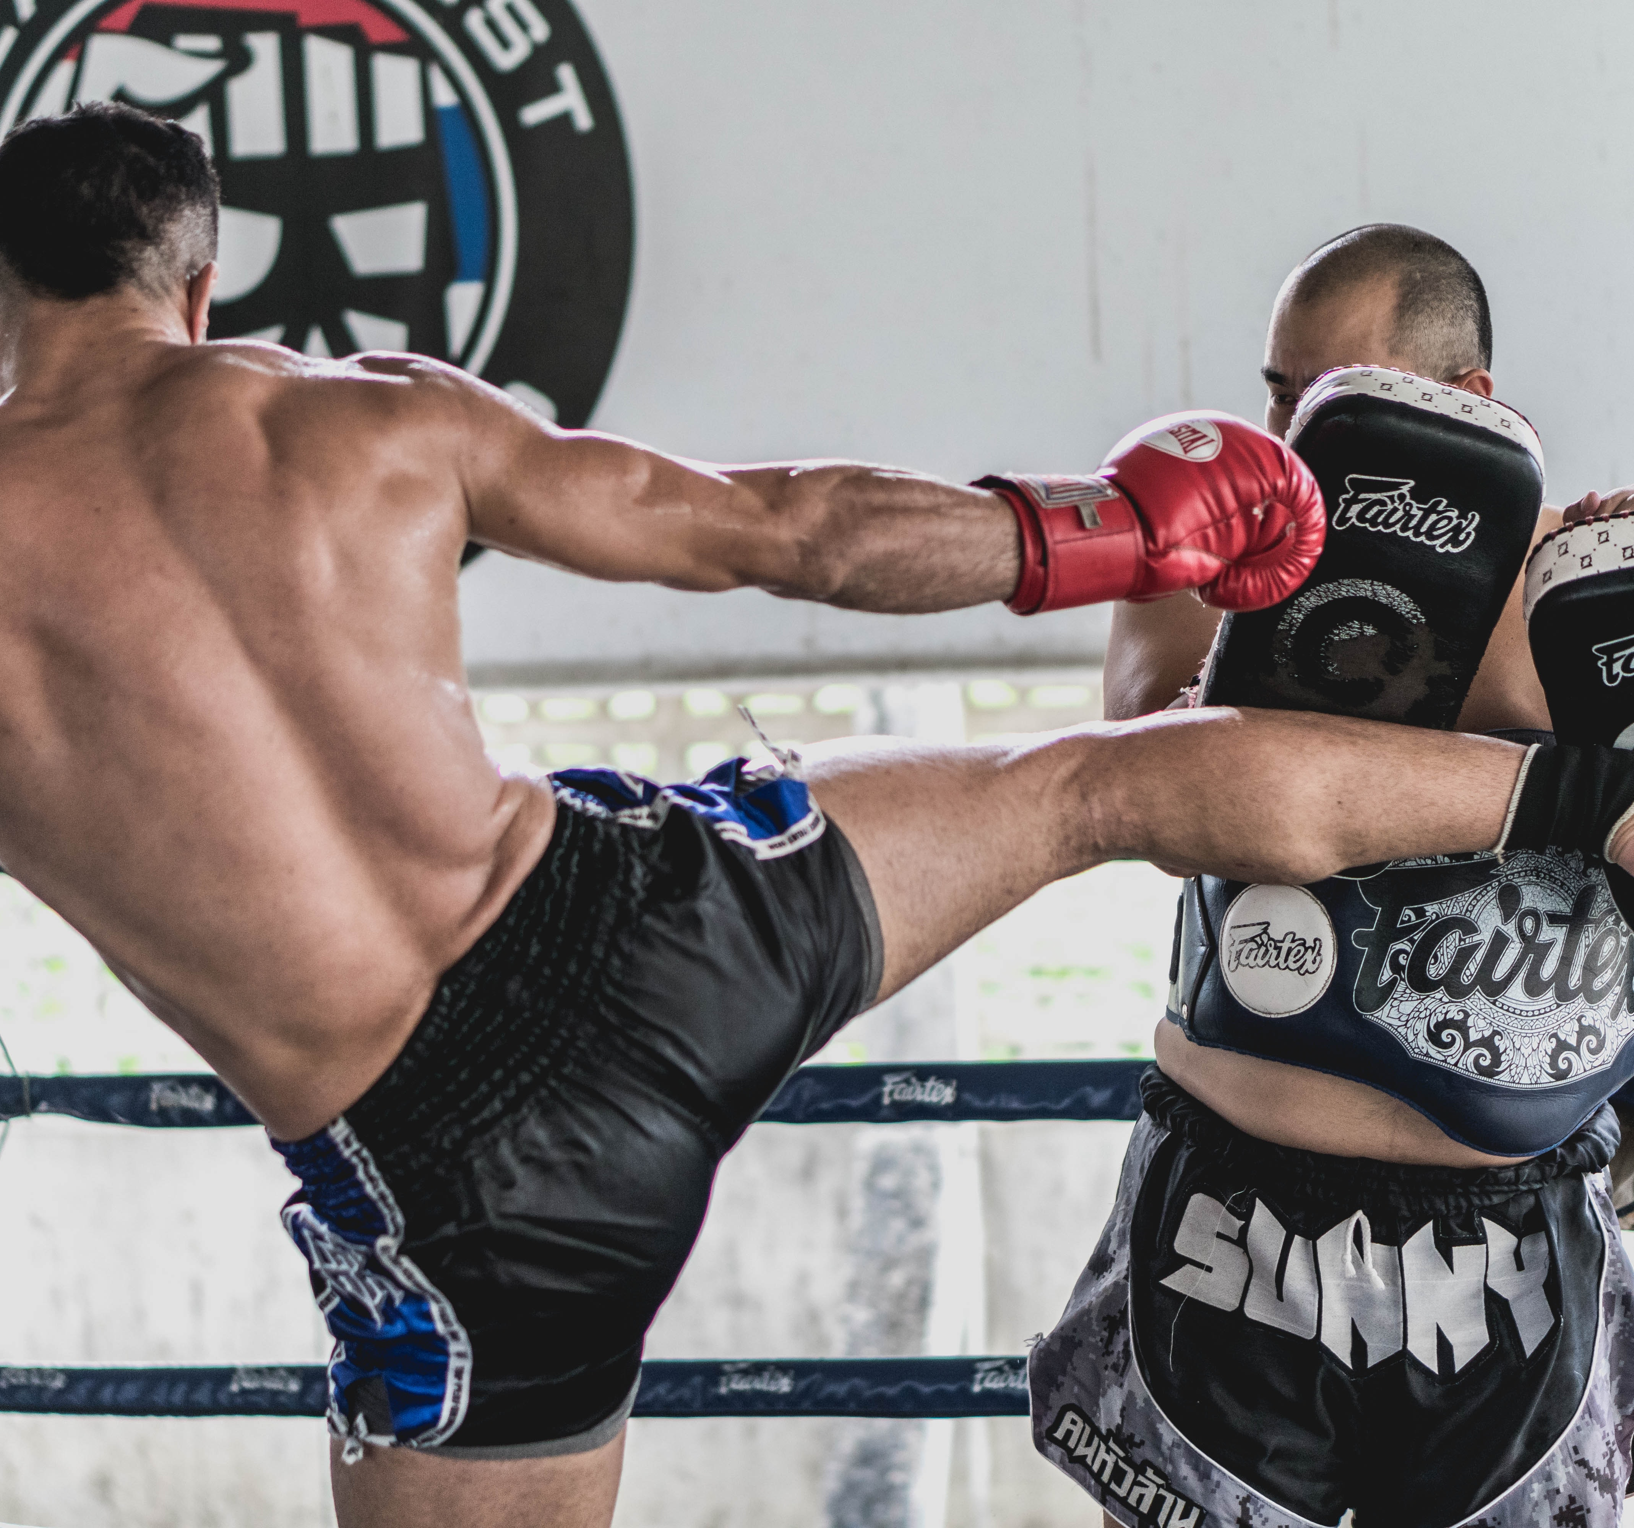
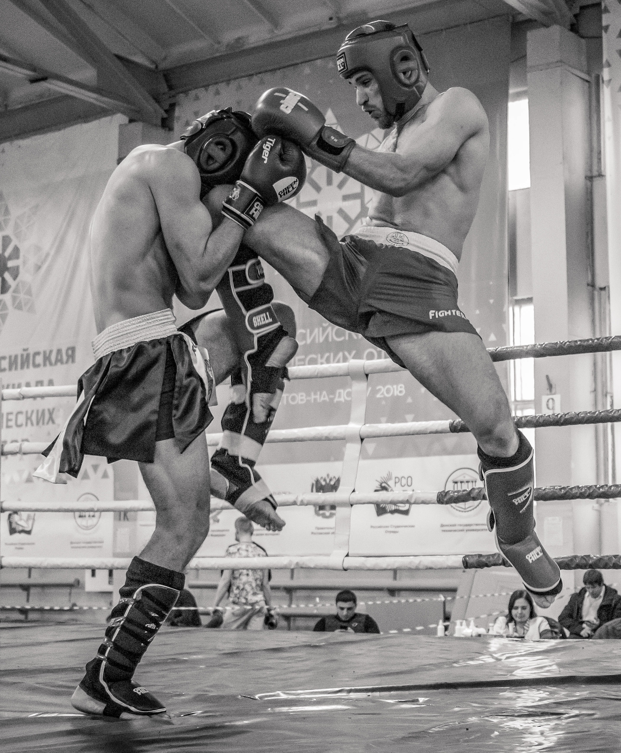
The role of the coach/trainer

Slide 50
Your role is definitive to the personality development of young athletes. You are high priority persons when it comes to promoting clean sport, whilst you can positively or negatively influence the psychology and state of mind of your athletes.​
​
You are obligated to be always aware and not neglect that excessive training, constant pressure for high athletic performance and unattainable targets, may progressively lead your athletes to crossroads where a wrong decision could really hurt them and their career.
​
Examples of the aforementioned are the severely restrictive diets, overfatigue and the injuries which come along with it, the overconsumption of dietary supplements and the use of prohibited substances and methods.

Slide 51
Your role is:
to help your athletes achieve their goals
to teach them respect and empathy
You are obligated to promote safety, good health, integrity, balance and the satisfaction which an athlete can acquire from fairness and fair play in general as a concept
You are obligated to cultivate ethics to your athletes through sports
In any other case, athletes may develop behaviors similar to deceiving, lying, arrogance and crave for victory employing any means regardless of any ethics, values, virtues or their health, economic, social, psychological status

Slide 52
It is paramount to preach respect towards themselves and their opponents. Athletic skills must be developed in contradiction and in irrelevance with the pursuit of materialistic victory. That will help athletes to win and lose with dignity and to respect the spirit of clean sports.​
The values above are emphasized by sharing credit and congratulating your athletes regardless of the game’s result. You should have a positive attitude whilst you observe the game and speak positively for the opponents after the game.

Slide 53
The above values are emphasized by sharing credit and congratulating your athletes regardless of the game’s result. You should have a positive attitude whilst you observe the game and speak positively for the opponents after the game.
The athletic environment culture is essential. The athletes spend a lot of their time in that environment, and they get influenced by all the stimuli in there, which intervenes into and reforms their way of thinking.​
The athletic environment must be evaluated and monitored regarding undesired behaviors. You are obligated to evaluate the behavior of the ASP pertinent to the sports values, their personal development and their integrity.

Slide 54
Furthermore, you should use your athletes’ “failures” as opportunities for learning and evolving.​
A good indicator for monitoring their psychological pressure is their stress levels. You are supposed to assist them in maintaining their physical and mental balance. ​
Athletes must learn to be organized and punctual regarding their training programs, to ask for assistance, to seek for orientation when they get disoriented and confused and to prioritize their health, recovery and nutrition.

Slide 55
Balanced nutrition and appropriate recovery can enhance their athletic performance and health. Occasionally, athletes resort to dietary supplements to cover their nutritional needs.
Dietary supplements can potentially endanger athletes’ health and career.
You are obligated to inform your athletes that they are exclusively responsible for whatever is found in their bodies, as they bear full liability of what they consume.
There is no guarantee that they do not contain a prohibited substance. Long story short, there are no guaranteed safe dietary supplements.
The legal regime is quite lenient. There are not substantial confines in the dietary supplements industry.
Balanced nutrition is the safest way to enhance your athletic performance.
Strict liability

Slide 56
ROLES AND RESPONSIBILITIES OF ASP
21.2.1 To be knowledgeable of and comply with all antidoping policies​ and rules adopted pursuant to the Code, and which are applicable to them or the Athletes whom they support
21.2.2 To cooperate with the Athlete Testing program
21.2.3 To use their influence on Athlete values and behavior to foster anti-doping attitudes
21.2.4 To disclose to their National Antidoping Organization and International Federation any decision by a non-Signatory finding that they committed an antidoping rule violation within the previous 10 years

Slide 57
21.2.5 To cooperate with Antidoping Organizations investigating ADRVs​
[Comment on article 21.2.5]: Failure to cooperate is not an ADRV under the Code, but it may be the basis for disciplinary action under a Signatory’s rules.
21.2.6 Athlete Support Personnel shall not Use or Possess any Prohibited Substance or Prohibited Method without valid justification.

Slide 58
Athletes have many rights and responsibilities during a doping control. You can help through this procedure by being aware of those: ​
During the doping control, the athlete has the right to: ​
Being chaperoned by a representative throughout the procedure. You could easily play that role.
Check after a request, the credentials of the DCO (Doping Control Officer).
Request for amendments should he bear any kind of disability.

Slide 59
FAQ
May the coach/trainer sign the DCF (Doping Control Form) with the athlete’s consent? ​
Is pseudoephedrine (cold & flue) prohibited in competition?
In cases of a disability, yes, he may. For instance, if an athlete has a vision impairment, he can authorize his coach to sign the form for him.
Yes! Pseudoephedrine is a substance with an action threshold, and it is in-competition prohibited if it surpasses the designated concentration limit.
Can I search for active substances of pharmaceutical medications in Global DRO, to help my athletes determine whether they are prohibited or not?
Yes! Athletes, trainers/coaches and parents can employ Global DRO to determine whether an active substance is prohibited or not.

Slide 60
End of 4th Chapter
Return to contents

Slide 61
Risks of supplement use

Slide 62
Dietary supplements are products which aim to supplement the nutrition
They are not medicines and they do not intend to treat, diagnose, mitigate, prevent or cure diseases
FDA (Food & Drug Administration) is the Federal agency which oversees both supplements and medicines
The FDA regulations for dietary supplements are different from those for prescription or OTC (Over The Counter) medicines
Respectively, EMA (European Medicine Agency) is the Europe regulator and EOF the Greek one. However, they are only responsible for medicines
EOF and EMA are not responsible for dietary supplements. In Europe, dietary supplements are registered in the “foods” category and only EFSA European Food Safety Authority, is concerned with them under a very lenient regime with no substantial limitations

Slide 63
Medicines must get approved from FDA, EMA and EOF before they get marketed or sold
Dietary supplements DO NOT need such an approval
The dietary supplements companies are responsible to bear documents which will prove that their products are safe, and their label claims are valid and not misleading
However, if the product does not entail a new dietary ingredient (which has been registered in the relevant list after 15 October of 1994 for the FDA and 1997 for EFSA), the company does not bear any responsibility to provide such documents to FDA or EFSA, before the product gets marketed.

Slide 64
The labels of dietary supplements may contain health related claims
The manufacturers bear the right to include in their labels that, for example, a dietary supplement promotes good health and supports a human body function (e.g., cardiovascular or immune system)
Those allegations should be followed by “This claim has not been examined by FDA. This product does not intend to treat, diagnose, mitigate, prevent or cure diseases”.

Slide 65
Red Flags of dietary supplements
High risk companies
The manufacturer or company has received FDA warning letters or has been subject to other enforcement actions. Search for the company or product name on FDA.gov or FTC.gov
Products sold exclusively on the internet
While there are some legitimate dietary supplement companies that only have an online presence, some companies deliberately avoid regulatory agencies by opening and closing websites quickly and selling their products online
Products claiming to be FDA, EMA, WADA, EOF approved
These organizations DO NOT approve dietary supplements

Slide 66
Red Flags of dietary supplements
Advertising contains too good to be true phrases
“Newest scientific breakthrough”
“Secret formula”
“money back guarantee”
“quick fix”
What the experts don’t want you to know”
“100% doping free”
“100% safe”
The supplement is advertised to be a thermogenic or stimulant-based weight loss or energy product or sexual enhancement product or a hormonal anabolic product
Companies often add stimulants, Viagra-like drugs, or steroids to their products so they “work”, but they might not list those ingredients on the label
The product claims to treat or prevent a disease
Hormone imbalances, the common cold, flu diabetes, and inflammation

Slide 67
Red Flags of dietary supplements
The product claims to deliver the same results as a performance-enhancing drug
Increase or decrease (adjustment) hormone levels
Increased muscle mass
The product is recommended by a gym trainer instead of a healthcare provider or dietitian
The product is not certified by a third-party certifier
However, even if it is certified, it does not mean that every batch of a product is getting tested. Some batches get tested and that is why the risk is not completely eliminated
Nonetheless, even if a doctor or a dietitian suggests a dietary supplement it is strongly recommended to doublecheck it on your own and ask for a second opinion of an expert

Slide 68

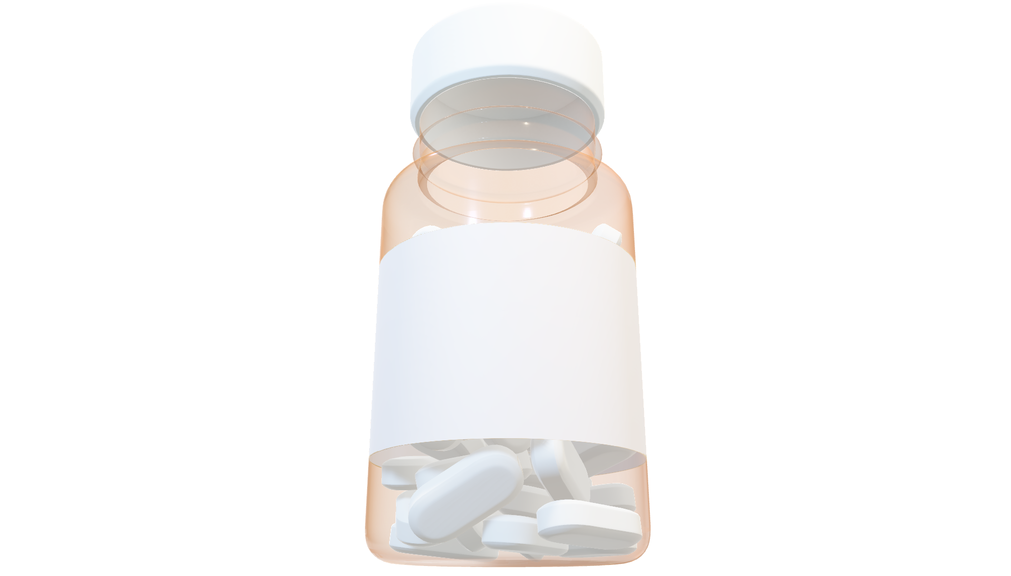
Red flags
The product uses chemical names instead of common names. It also lists unrecognizable ingredients which seem out of place
Any product which is taken in any other way than eating or swallowing, such as skin patches, creams, injections and drops may contain a prohibited substance. The same applies to products that require extra steps before swallowing, such as placing it under the tongue or swishing it around in your mouth.
Uses Chemical Name
The supplement label includes WADA prohibited list substances, or similar substances from the same categories of the prohibited list
WADA Prohibited Substances
Andro -oil -diol -dione -stene -stane 17a 17b 17d epi epithio gonado
*any other number with the alpha & beta symbols or other Greek symbols
Skin Patches, Injections, Drops
*any extra step to swallowing
Any of the following characters or phrases may indicate the presence of a steroid and in general anything that is being presented in a chemical formula form
No nutritional value listed
The nutritional value of the ingredients is not clear or well-documented. If you have never heard of an ingredient, then it would be best to stop and do some research first.

Slide 69
Moderate risk
No risk

Slide 70







3rd Party Certifiers of dietary supplements
sport.wetestyoutrust.com
nsfsport.com
koelnerliste.com
hasta.org.au

Slide 71

Meat Contamination
In Competition
Anabolic Agents
Out of competition
Growth promoters for faster animal development to meet the market demand
Zilpaterol is used in many countries for cattle.
Consuming meat that contain residuals of these anabolic agents
Small concentrations of these substances in the urine/blood sample
Clenbuterol
Protein sources
Zeranol is used in many countries for cattle.
China
beef
Mexico
liver
Guatemala
Chicken
Fish
Ractopamine is used in many countries for cattle, swine, and large breed turkeys.
Legumes
Clenbuterol is used in China as a growth promoter for cattle, lamb, poultry and swine

Slide 72
End of 5th chapter
Return to contents

Slide 73

SAMPLE COLLECTION PROCEDURE

Slide 74
PRESENTATION GOALS
To learn basic definitions and roles regarding doping control.
To comprehend the basic steps of the doping control procedure.
To learn the athlete’s rights and responsibilities during the doping control.
To get accustomed with the urine/blood doping control procedures and with the doping control form.
To learn about some special circumstances and cases (such as delays) and the partial sample.

Slide 75

WHAT IS DOPING CONTROL?
All the steps and procedures, from the design of the control, up to the final deposition of any objection and the sanction enforcement, including:
Providing whereabouts
Collection and management of samples
TUEs (Therapeutic Use Exceptions)
Laboratory analysis
Results Management and hearing procedures

Slide 76
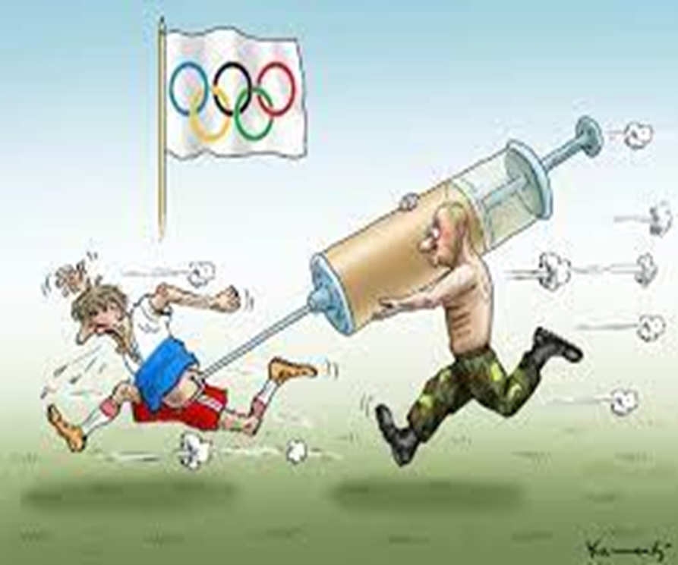

WHO CONTROLS THE ATHLETES?
National Anti-doping Agencies (NADOs)
International Federations (IFs)
Major Event Organizations (MEOs)
Independent Private Agencies (π.χ. IDTM, ITA)
WHICH ATHLETES GET CONTROLED?
Any athlete who belongs in the jurisdiction of an Anti-doping Organization (ADO) and is subject to its regulation.

Slide 77





DEFINITIONS & TERMINOLOGY OF DOPING CONTROL
Doping Control Officer (DCO)
An adequately trained and authorized person who can collect a urine sample from an athlete.
Chaperone
A trained and authorized employee who executes specific duties, such as notification, escort, supervision and eye-witnessing of the sample collection.
Blood Collection Officer (BCO)
A person who has the qualifications and is authorized to collect a blood sample from an athlete.
Doping Control Form (DCF)
The formal document which athletes fill during the doping control procedure.
Doping Control Station (DCS)
Where the sample collection takes place.

Slide 78







STEPS OF DOPING CONTROL PROCEDURE
Athlete selection
Athlete notification
Sample collection procedure
Document filling
Supervision sequence
Lab Analysis
Results Management

Slide 79




ATHLETE SELECTION
Weighted Selection
Random Selection
Targeted Selection

Slide 80

ATHLETE NOTIFICATION
Athletes get notified for their selection to be submitted to a doping control by a Doping Control Officer (DCO) or a Chaperone who bears and exhibits their relevant ID.
Athletes get informed for their rights and responsibilities.
Athletes are asked to present a valid identification document (e.g. ID, driver’s license, athletic ID card).

Slide 81

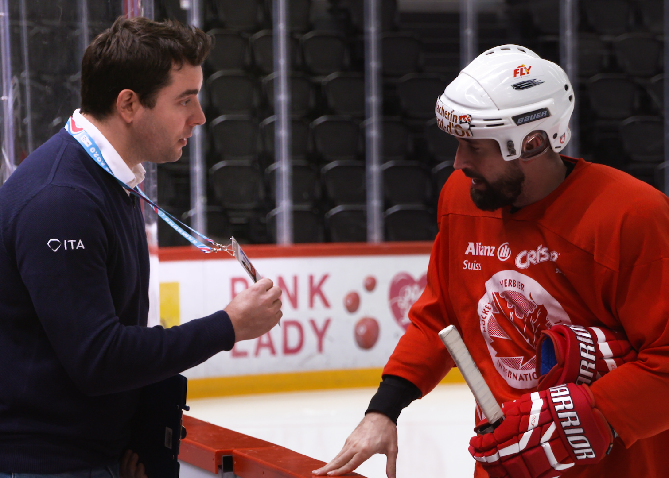


ATHLETE’S RESPONSIBILITIES DURING THE DOPING CONTROL PROCEDURE
Immediate arrival at the Doping Control Station.
Presenting a valid ID document.
Remaining under constant supervision of the Doping Control Personnel.
Comply with the doping control rules..

Slide 82






ATHLETE’S RIGHTS
To be chaperoned by a representative.
To request for the presence of a translator.
To ask for the DCO and the Chaperone to exhibit their ID documents
To ask anything regarding the procedure.
To request for special assistance or differentiation of the procedure (athletes with an impairment).
To write down any comments or objections pertinent to the procedure at the Doping Control Form.
To delay his arrival at the doping control station under certain conditions.

Slide 83




REASONS FOR DELAYED ARRIVAL
Award ceremony.
Completion of training or participation on next sport event.
Medical care treatment.
Attending media activities (Only In-Competition).
Recovery after training (stretching etc.)

Slide 84
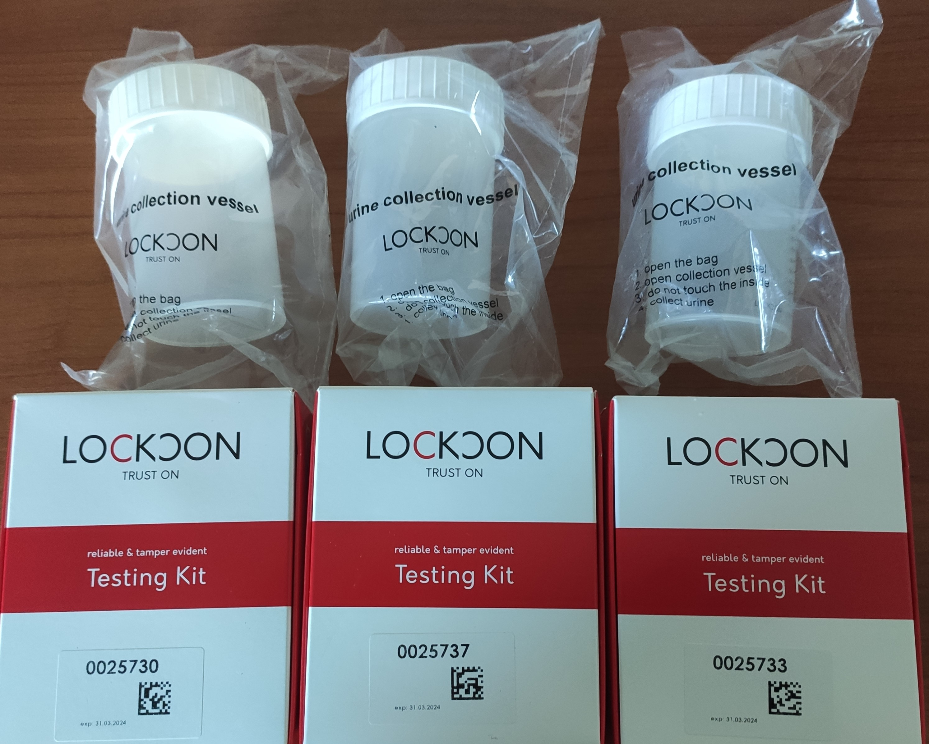
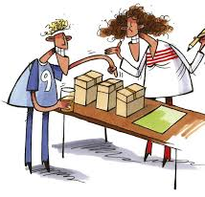
URINE SAMPLE COLLECTION
Athletes pick urine collector and a saving box out of at least 3 packages.
Athletes must provide at least 90 ml.
It is paramount to have at least that volume as the labs test the sample for more than 200 substances.

Slide 85
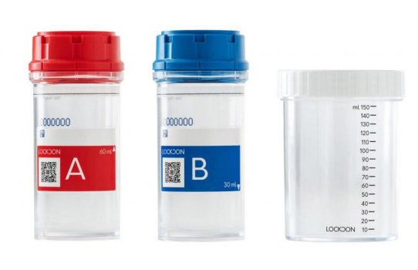
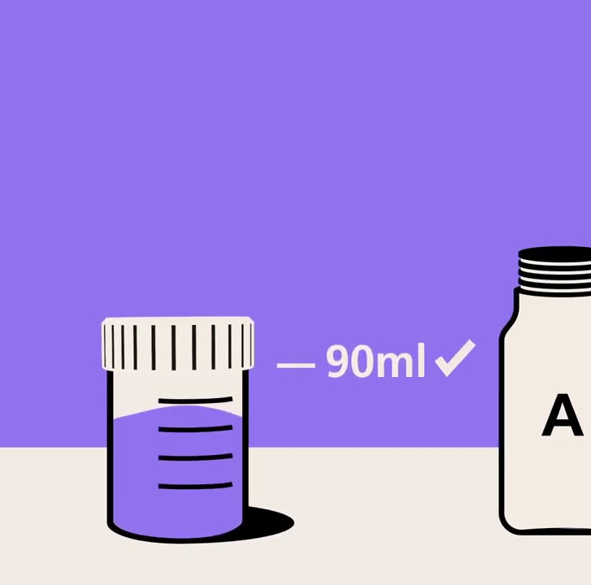
URINE TESTING
The athlete washes his hands with water ONLY.
The athlete removes his clothes from the middle of his torso to the middle of his thighs and the Doping Control Personnel watches while the urine comes out of his/her body.
The athlete is encouraged to fill the urine collector with more than 90 ml
If the urine collector gets filled, the athlete gets instructed to empty his blader in the toilet.

Slide 86
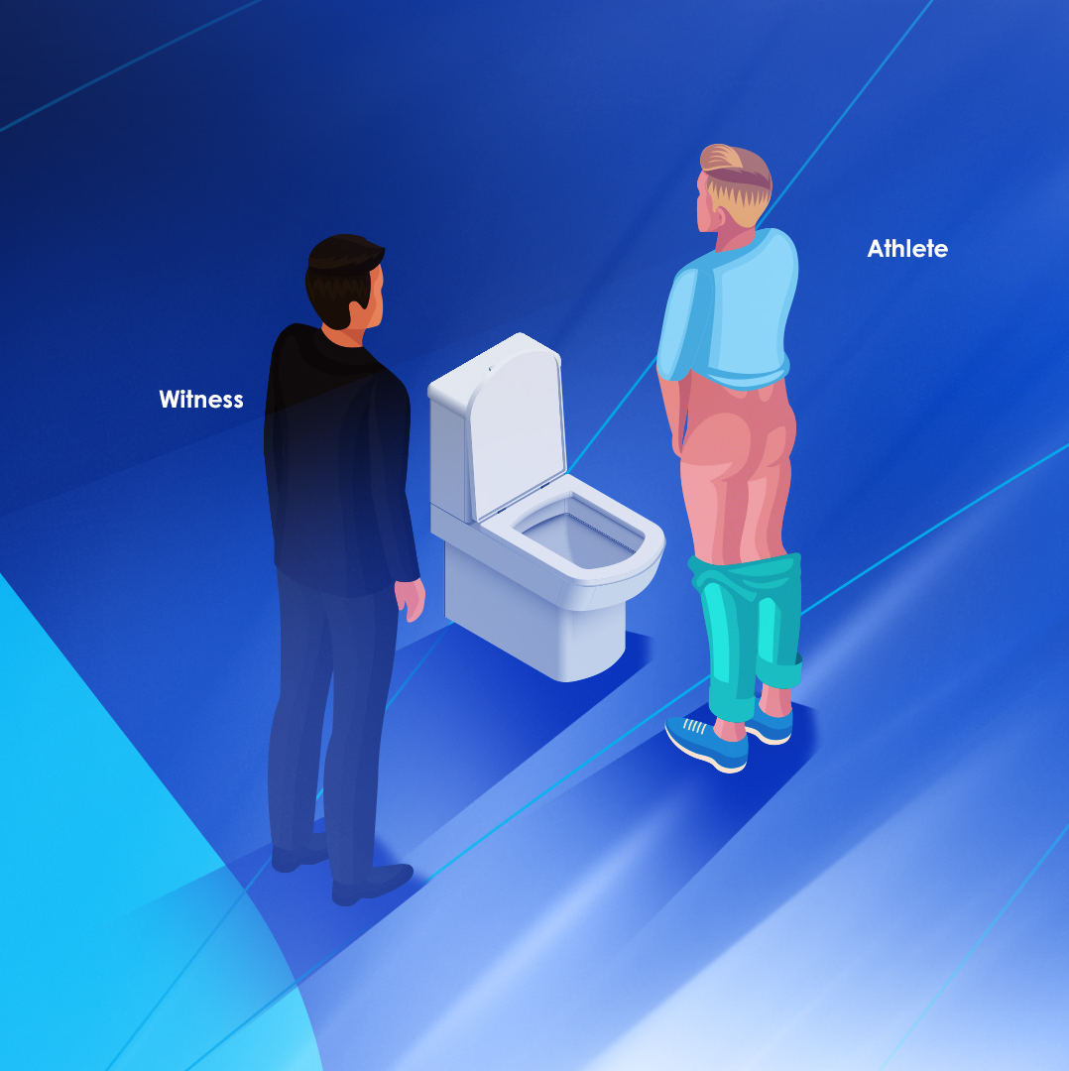
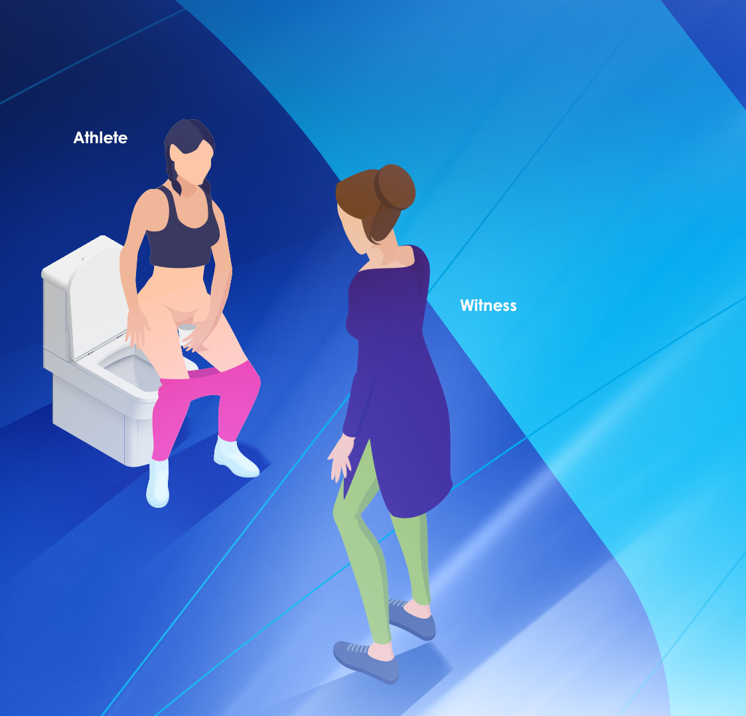
URINE SAMPLE PROVISION
Eye-witnessing the urine deposition is MANDATORY
Male sample deposition
DCO/Chaperone stands beside the athlete
Female sample deposition
DCO/Chaperone stands in front of the athlete

Slide 87
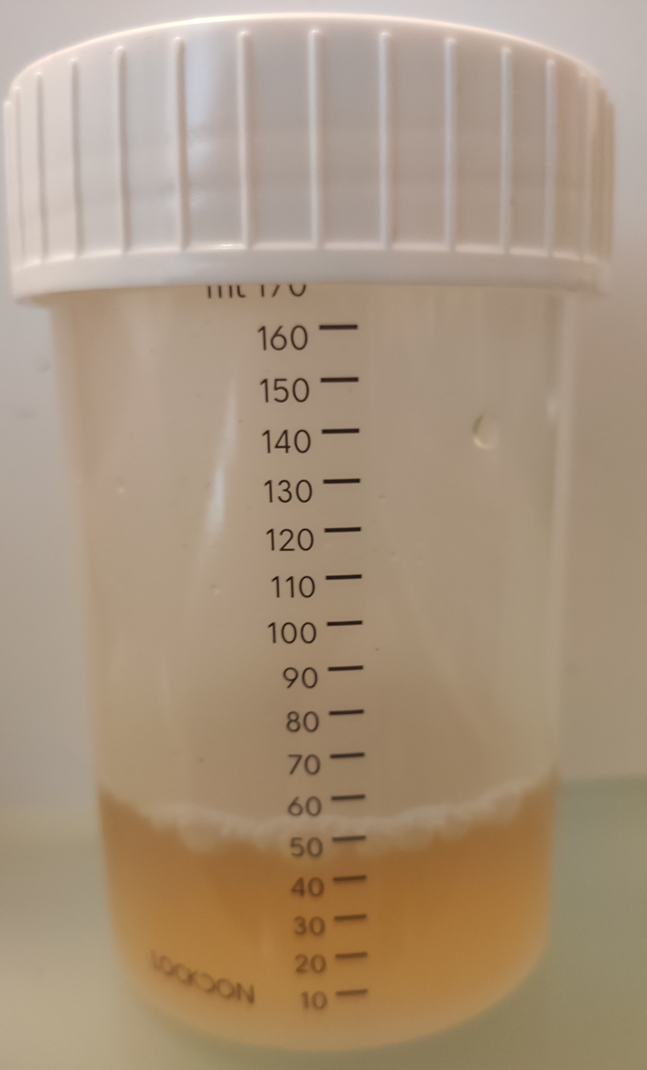
PARTIAL URINE SAMPLE
Anything less than 90ml is considered a partial sample.
In such case the sample, gets sealed and secured until the athlete is ready to provide a new sample.
The athlete picks a new urine collector, and the 2 samples get summarized until the volume ≥ 90 ml.
Then the urine gets separated in vials A and B as aforementioned.

Slide 88


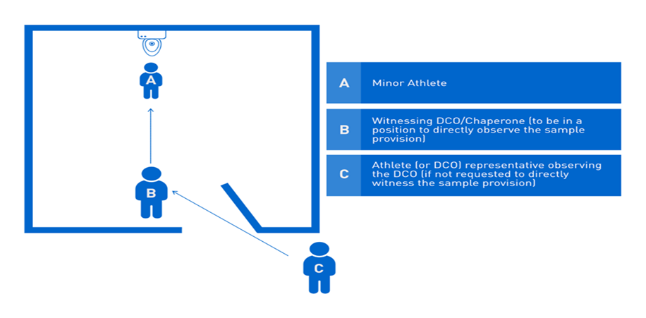
INSTRUCTIONS FOR MINOR ATHLETES
Sample provision of a minor
The DCO/Chaperone directly observes the athlete. The witness (representative) observes the DCO/ Chaperone and not the athlete
A minor athlete must always be chaperoned by an adult representative, at every step of the doping control procedure (notification, sample provision, signing of documents etc.)
A parent, trainer/coach, or team chaperone may be the representative.
The athlete’s representative remains by the athlete’s side throughout the doping control procedure. However, he may not observe the sample provision, unless the athlete requests so.
The DCO will request for the representative to be present at the bathroom area and watch him as an eye-witness of the sample provision.

Slide 89
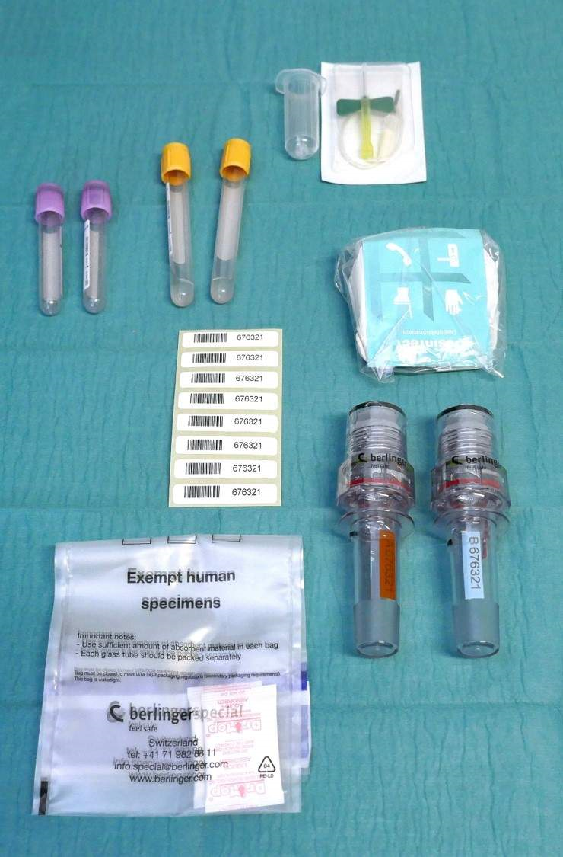
BLOOD SAMPLE COLLECTION
Notification and Identification
Same as in urine sample procedure
Selection of sample kit:
Same as in urine procedure
The athlete remains seated for 10’
The BCO collects
At least 3 ml
Up to16 ml
Sample gets sealed
Filling of documents and signatures
Same as in urine procedure

Slide 90
Personal Data Filing
Informing the athlete of his Rights and Responsibilities
Careful check of the sample number
We state all medications/supplements intake and TUEs
We check if the information filled in the form is accurate. We write down comments or observations

Slide 91
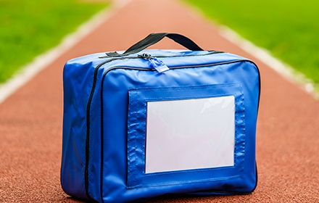





WHERE DOES THE SAMPLE END UP?
The samples get securely packaged in transportation bags.
The get sent to a WADA certified Lab and get submitted for analysis.
The whole procedure gets tracked and registered in specific documents on every step, to ensure the sample’s safety and that they remain intact.
The blood samples are always stored in specially designed fridges with special thermometers which constantly record the temperature needed.

Slide 92
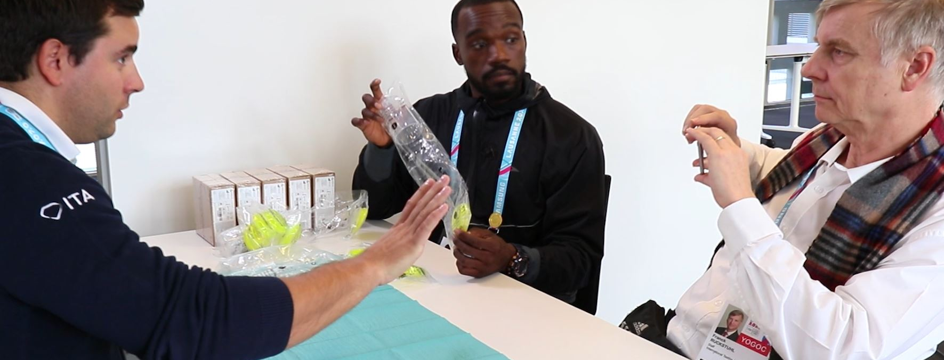
ATHLETE’S CHAPERONES
They play a substantial role in facilitating the whole procedure by providing support to their athletes and to the Doping Control Personnel, on each stage of it.
They also have the right to write down on the Doping Control Form any comment or objection they may have.
Especially in the case of minor athletes, their presence is necessary throughout the doping control procedure.

Slide 93

TO SUM UP…
Athletes must be aware of their rights and responsibilities during the doping control process – this includes their right to request for a delayed arrival at the Doping Control Station due to substantial reasons and other amendments on the procedure.
Athletes must always follow the DCO/Chaperone and BCO instructions. Athletes should feel comfortable enough to ask any questions during the doping control procedure.
Athletes who are in no position to provide the required urine volume or density are obligated to provide further sample.
Athletes must correctly fill the Doping Control Form and double check all the details – especially the sample codes.

Slide 94
USEFUL LINKS
http://wada-ama.org
https://www.eokan.gr

Slide 95
End of 6th Chapter
Return to contents

Slide 96


ADAMS
&
REGISTERD TESTING POOL

Slide 97

L. 4791/2021 (Ε.τ Κ. τ. Α’ φ. 51/3-4-2021) Necessary amendments for harmonizing/complying the Greek Legislation with the reviewed Code of WADA, which is in place since 01/01/2021 (World Anti-Doping Code 2021).
International Standard for Testing and Investigations 2021.

Slide 98

ADAMS
Anti-Doping Administration and Management System (ADAMS)
It is the database where information gets registered, stored and disclosed amongst WADA, NADOs and IFs.

Slide 99
NADOs & ADAMS
They create control orders of athletes and teams
They check the whereabouts input which the athletes have stated, to conduct unnotified doping controls
They register the doping control results of the tested athletes
They register TUEs
They receive the test results from the WADA certified labs
They receive updates from APMU which get evaluated and if necessary, the samples get further investigated

Slide 100
In-Competition Doping Control
The In-Competition period commences at 11:59 pm of the day before the competition, in which the athlete is about to compete and concludes by the end of it.
Out-of-Competition
Any period that does not align with the aforementioned.

Slide 101
Registered Testing Pool 1 (RTP)
The list of high-profile athletes who have been selected by IFs and NADOs based on specific criteria. These athletes have the responsibility to submit their whereabouts and in case of noncompliance they may face an ADRV.
Testing Pool 2 (TP)
The athletes on this list have also the responsibility to submit their whereabouts. However, in case of noncompliance the consequences are less severe.
Other Lists
The demands are less at most times. Usually, the whereabouts for these athletes are submitted by their NFs or their teams.

Slide 102
Athlete’s inclusion criteria in the rtp
Athletes with substantial accomplishments in Greek, European, World competitions, Youth Olympics or Olympic games
Substantial performance improvement of an athlete during last season
Return in action after an injury
Return in action after a sanction which was enforced due to an ADRV
Return in action after departure for reasons except for an ADRV
Information leads, (doping intelligence) of HADA
Canceled participation of an athlete from an athletic competition in which he had submitted his participation or absence from an athletic competition in which his participation was expected
Athlete’s ADRV background
Athlete’s age
Sanctioned athletes

Slide 103
Account Registration

Slide 104
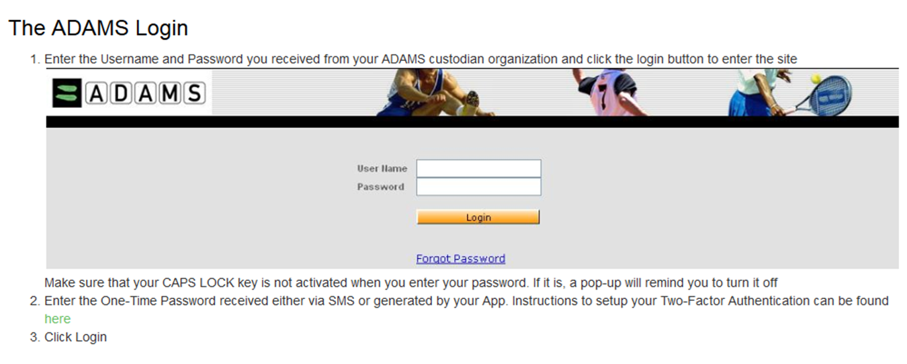
ADAMS Login

Slide 105
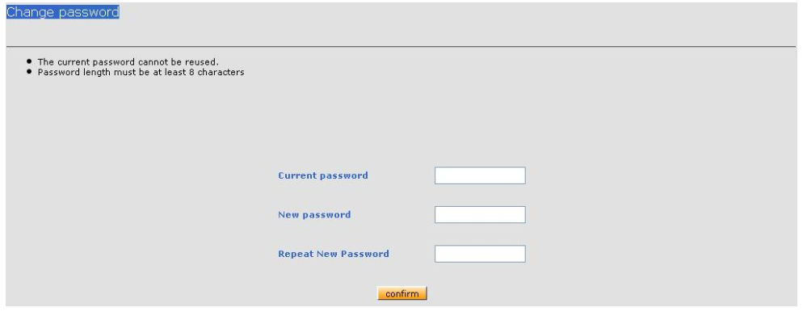
ADAMS Login
  Password Setting
    First connection with temporary code assigned by HADA
    You will have to set a new password with at least 10 characters (including caps, lowercase, numbers and symbols), for security reasons

Slide 106
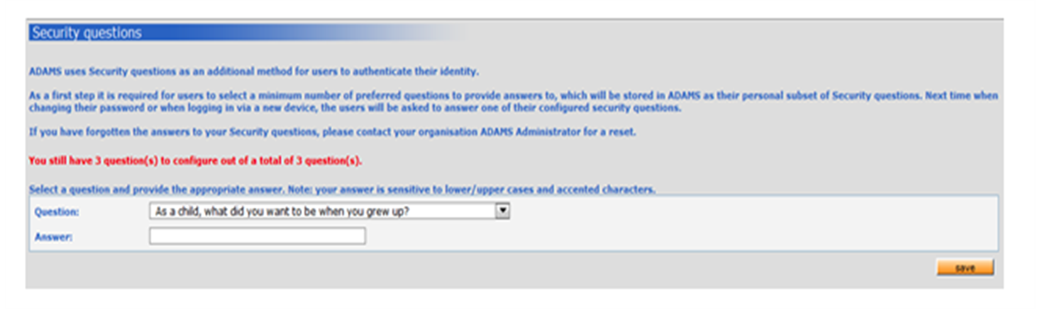
ADAMS Login
  Security Questions
    Choose to answer 3 security questions.
    Do not forget to check the box (trust this device in the future), in order to save the 3 questions, you chose to answer and pop them up in future logins from your part.

Slide 107
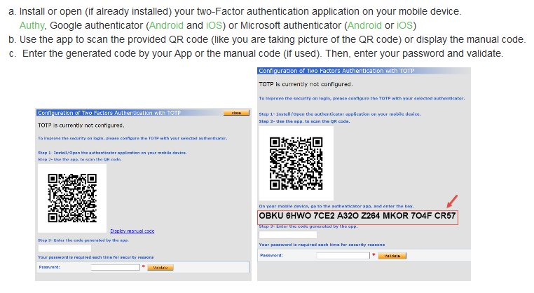
ADAMS Login
  Configuration of two factors
    You will be required to activate the two factors authentication (2FA).
      2FA is a “momentary” code.
      You will have to install an authentication app on your phone.
      Google Authenticator is recommended.

Slide 108
ADAMS
  two factors authentication
    Scan to get a password.
    If you log out of your account and want to log in again, you will have to insert the code on your phone, which the google authenticator will provide you.
    It is important that the time adjustment choice is in auto mode on your phone.
    In case you change your phone, you will have to communicate with E.O.KA.N./HADA because even if you download the app, it will not work.

Slide 109
  Log in failure
    If you try to log in on ADAMS by inserting the wrong username or password twice, the system automatically locks your account temporarily.
    To reconnect contact HADA to acquire a new temporary or the system will provide you the same option.
    If you connect and fail to answer the security questions correctly (e.g. you forgot the right answers) then the account gets the temporary locked indication, and you must contact HADA so that they delete the answers and reactivate your account.
    In case you don’t make any action for 30’ then you automatically get disconnected for security reasons.

Slide 110
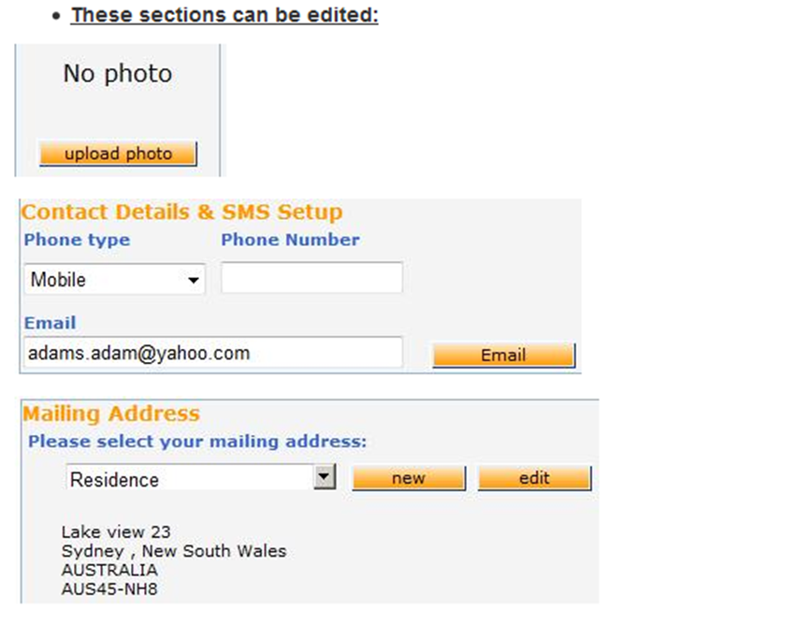
Correction of Profile Details
  You can change your photo or your contact details by clicking My Profile.

Slide 111
Rtp athletes submit their whereabouts on adams
Whereabouts are submitted quarterly on ADAMS and are accessible exclusively by authorized users.
E-mail & phone number
Overnight accommodation
60min Time Slot
Regular activities (e.g. training)
Competition schedule
Travelling plans
Further details

Slide 112
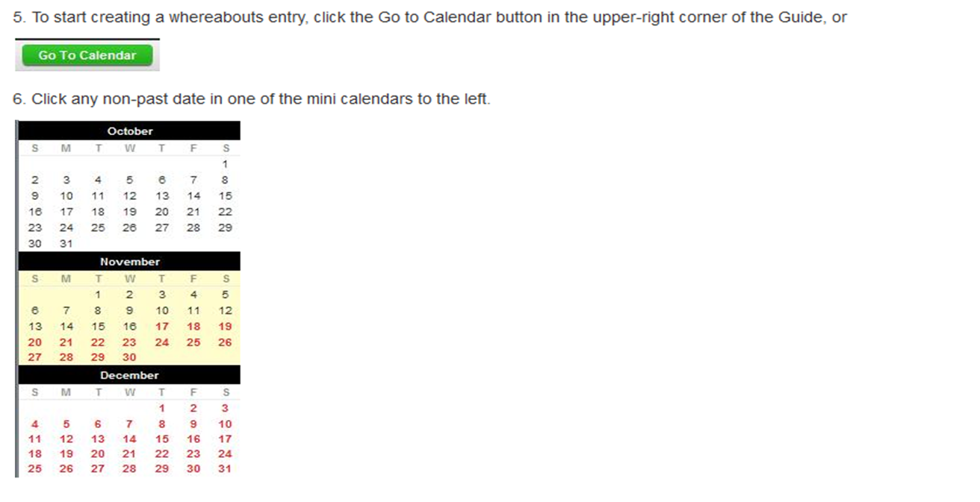
Whereabouts Entry
  Go to calendar and click the date when you want to start updating your info.

Slide 113
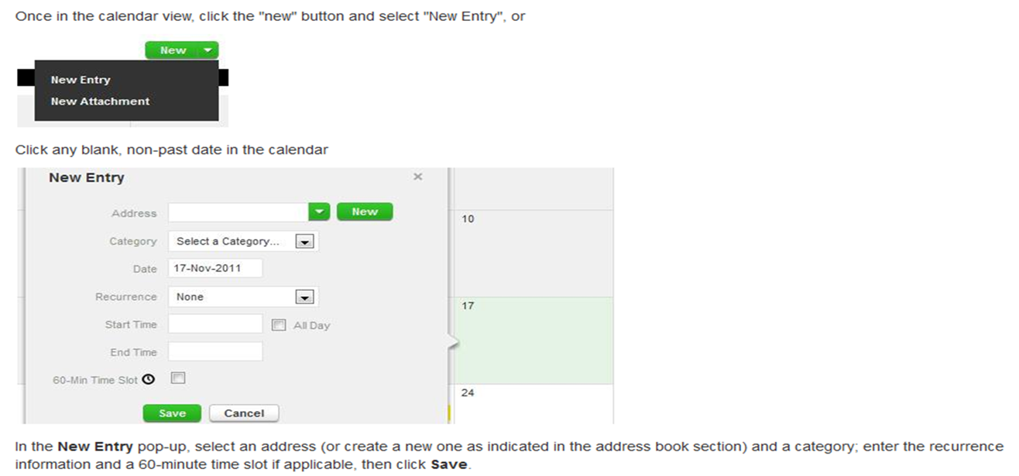
Whereabouts Entry
  Choose new entry and write down your address , select a category (overnight accommodation, competition e.tc.), weekly activities and 60min time slot.

Slide 114
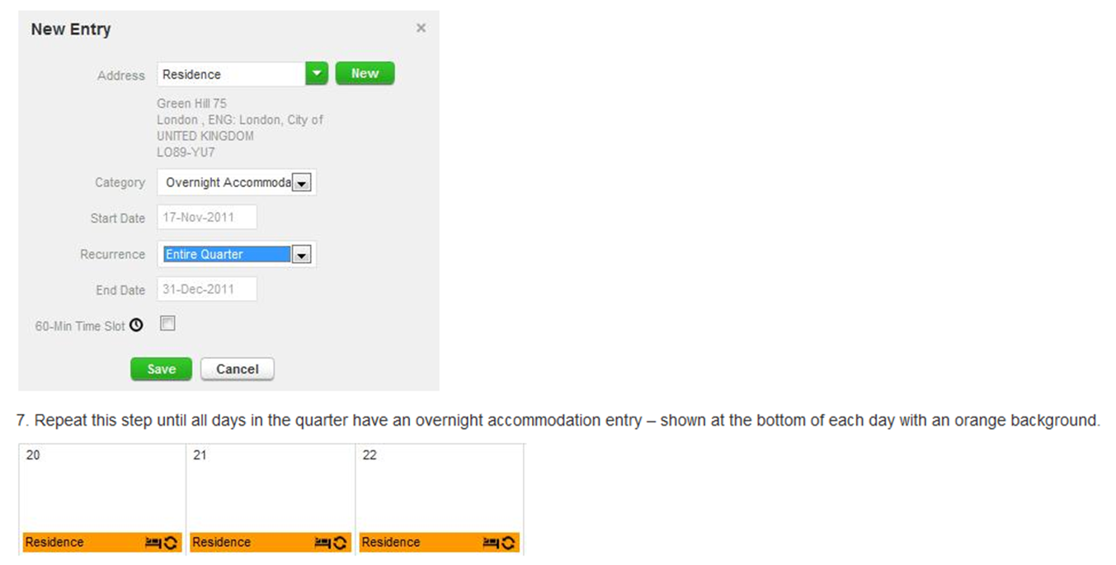
Whereabouts Entry
  The procedure repeats for each category.

Slide 115
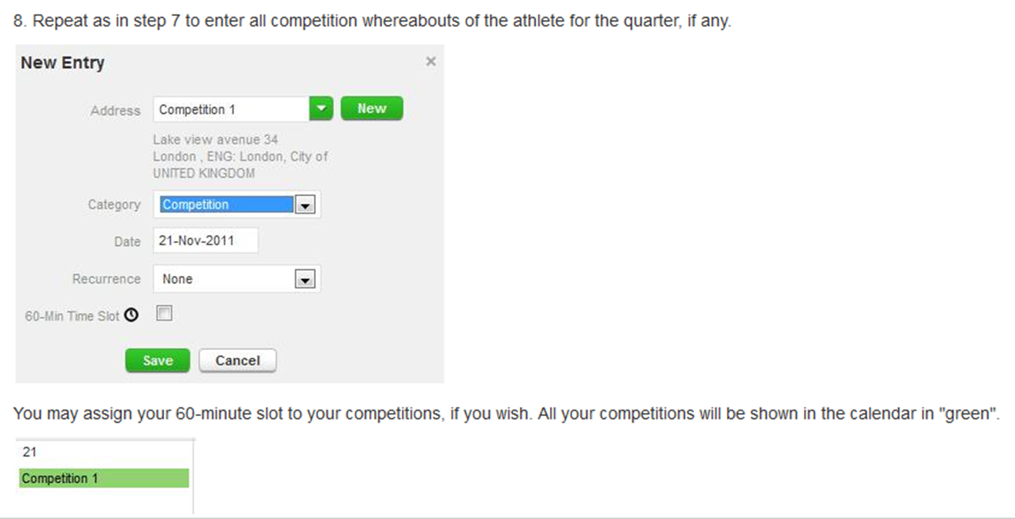
Whereabouts Entry
  The procedure repeats for each category.

Slide 116
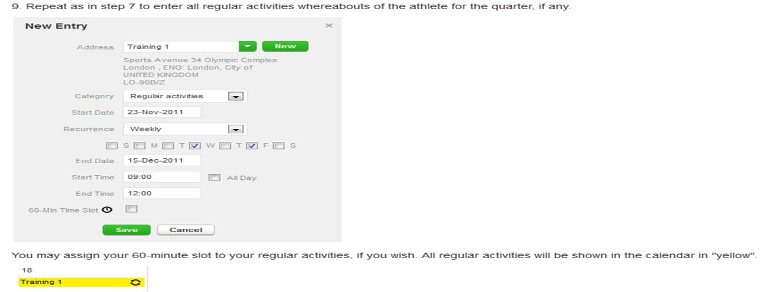
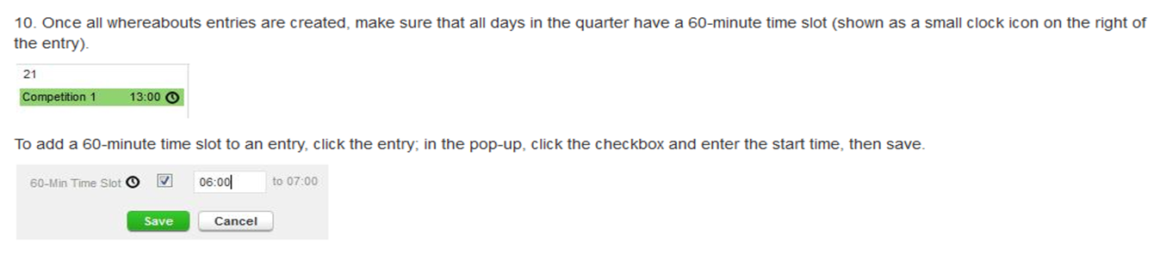
Whereabouts Entry
  The procedure repeats for each category.

Slide 117
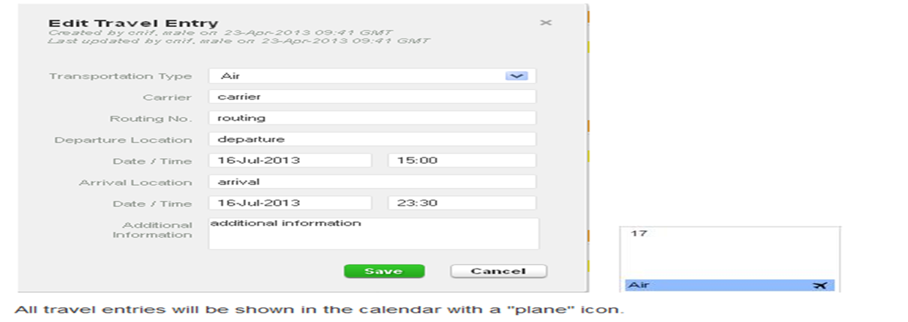
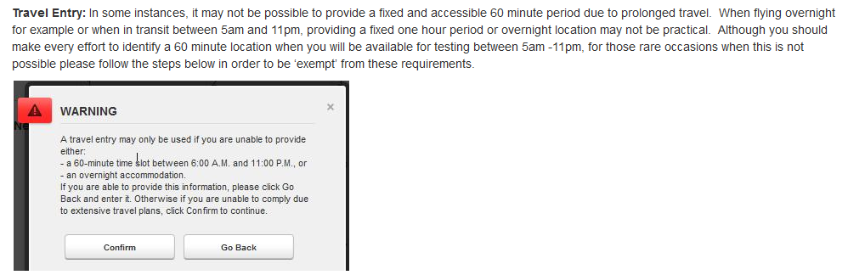
Whereabouts Entry

Slide 118
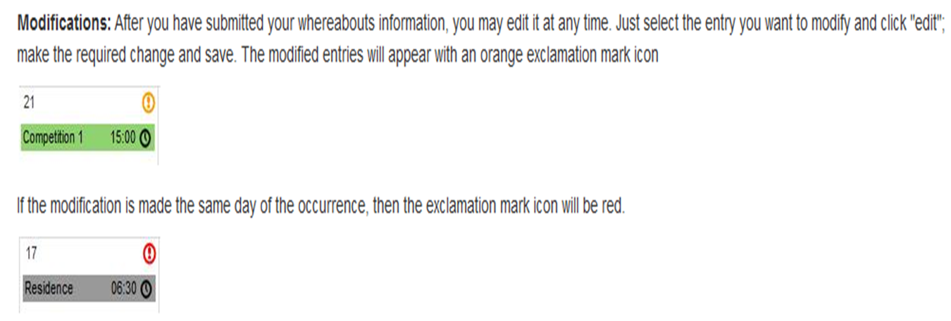
Whereabouts Entry
  The athlete can change some of their info. The changes which occur on the same day of the activity will be indicated with a red exclamation mark.

Slide 119
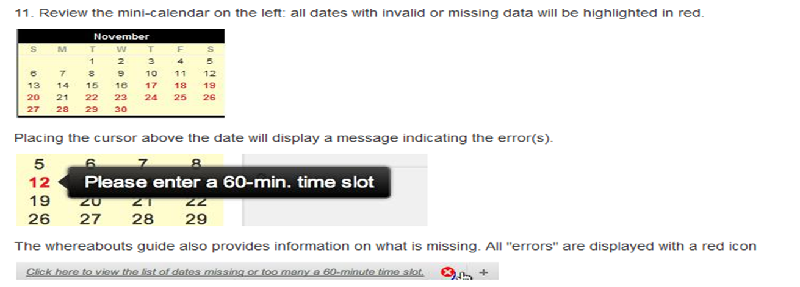
Whereabouts Entry
  When reviewing the calendar should there be any dates with missing data, they will be highlighted in red.

Slide 120
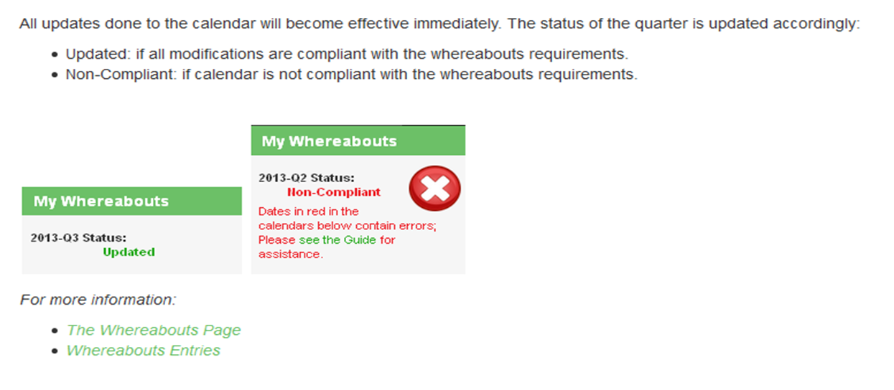
Whereabouts Entry
  All whereabouts updates become effective immediately.

Slide 121
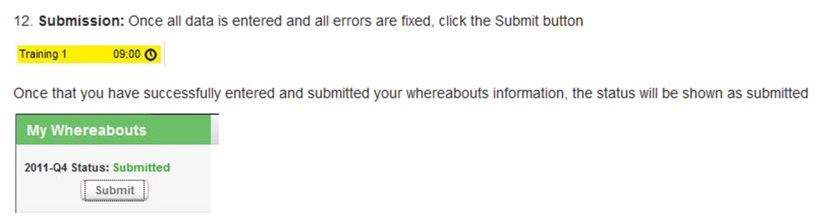
  Always remember to press
  SUBMIT !!!

Slide 122
End of 7th Chapter
Return to contents

Slide 123


Athlete Biological Passport (ABP)

Slide 124
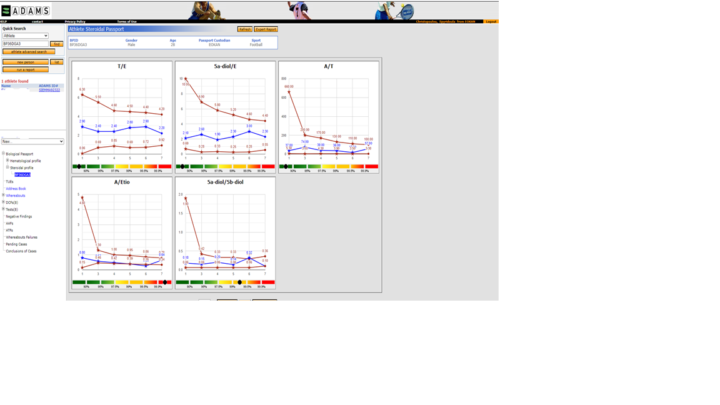
ABP was first employed in 2009 and represents an extremely important anti-doping tool.
It includes data documentation from the lab results of athletes’ urine and blood sample.
ABP monitors biological variables which indirectly indicate doping cases on the long run. Each significant fluctuation of the variables is monitored and assessed for any possible use of prohibited substances or methods.

Slide 125
End of 8th Chapter
Return to contents

Slide 126
Health, psychological and social consequences

Slide 127
Consequences
Psychological
Social
Health
They vary and are contingent upon the prohibited substance which is being used. At some cases they may be permanent.
In case of their occurrence, they may fluctuate from mild (e.g. acne and migraine) to extremely severe (e.g. heart attack, malignant tumor, pulmonary embolism)

Slide 128
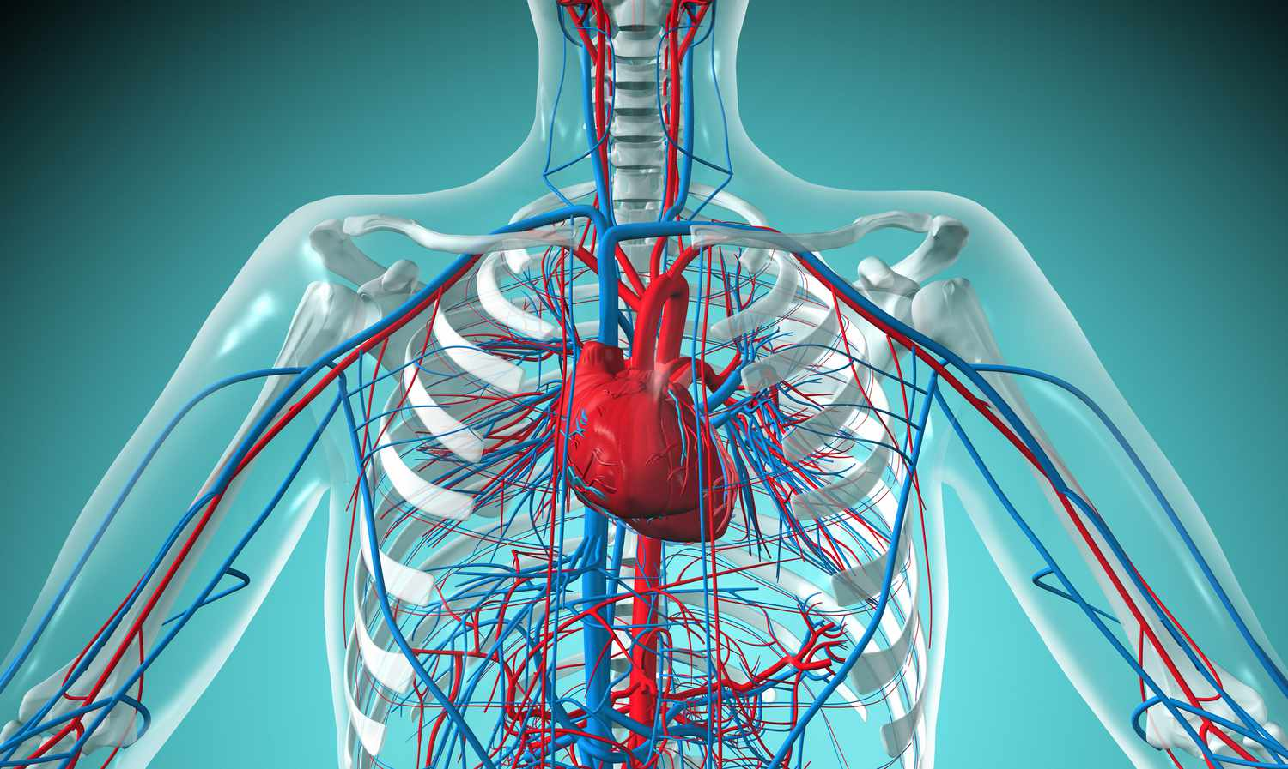
Reproductive System
&
Cardiovascular/Circulatory System
Reproductive System
Testosterone and anabolic agents:
♀ cessation of breast development, abnormal menstrual cycles, enhanced hair growth, deepening of the voice, enlarged clitoris
♂ breast tissue development, shrinking of testicles, impotence, sperm count reduction
Cardiovascular/Circulatory System
Human growth and peptide hormones: Hypertension, heart attacks, high blood pressure, heart failure
Diuretics: Hypotension, circulatory failure
Blood doping and EPO: Blood clotting, heart attacks
Stimulants: Increased heart rate, blood pressure, risk of cardiac arrythmia and heart attack

Slide 129

Brain and Nervous System
Testosterone and anabolic agents: cyclothymia, aggressiveness, memory problems and attention deficit
Withdrawal from anabolic steroid use can be associated with depression, and in some cases, suicide
Opioids: Loss of balance, coordination and concentration, physical psychological dependence; leading to addiction, failure to recognize injury
Stimulants: insomnia, anxiety, dependence/addiction, dehydration, tremors
Human growth and peptide hormones: loss of vision

Slide 130
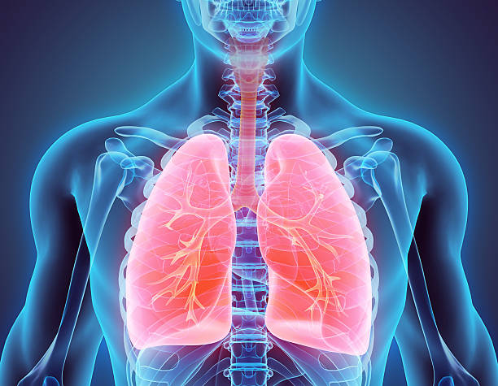
Lungs and Respiratory System
Opioids: suppressed respiratory system
EPO and blood doping: pulmonary embolism

Slide 131
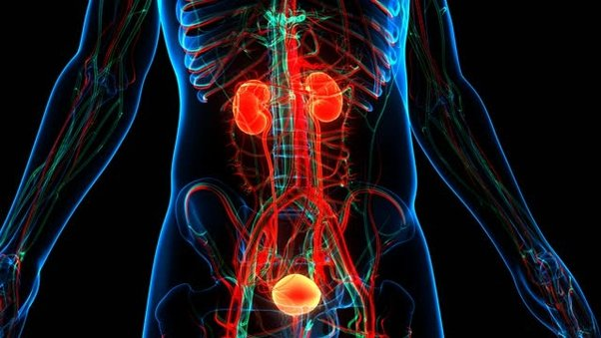
Kidneys and Excretory System
Testosterone and anabolic agents: acne (especially on the chest)
Diuretics: dehydration, kidney failure

Slide 132
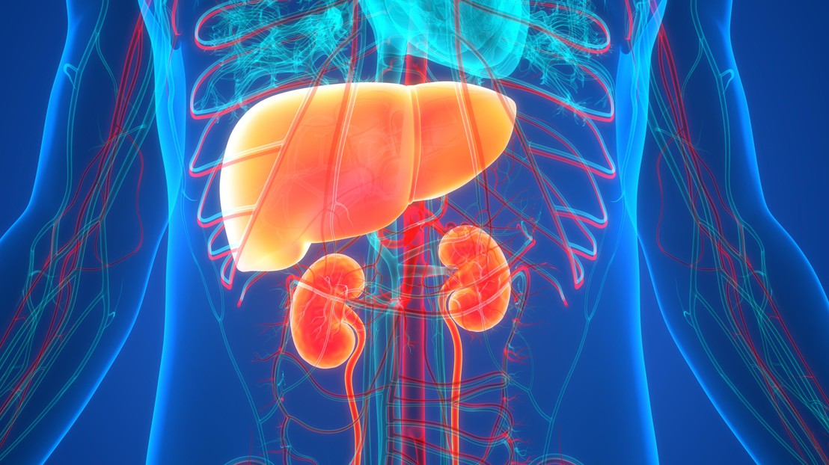
Liver
Testosterone and anabolic agents: liver failure
Human growth and peptide hormones: Diabetes and tumors

Slide 133

Consequences
Psychological
Social
Athletes and ASP persons are inclined to keep their distance from ADRV offenders due to 9th and 10th ADRVs (complicity and prohibited association)
The offender gets stigmatized for life. This has a negative impact on his social relationships, on the way he is being perceived by his social circle and on his credibility as a person
Health
All these ensue to social isolation and to him/her being constantly left out of everything

Slide 134
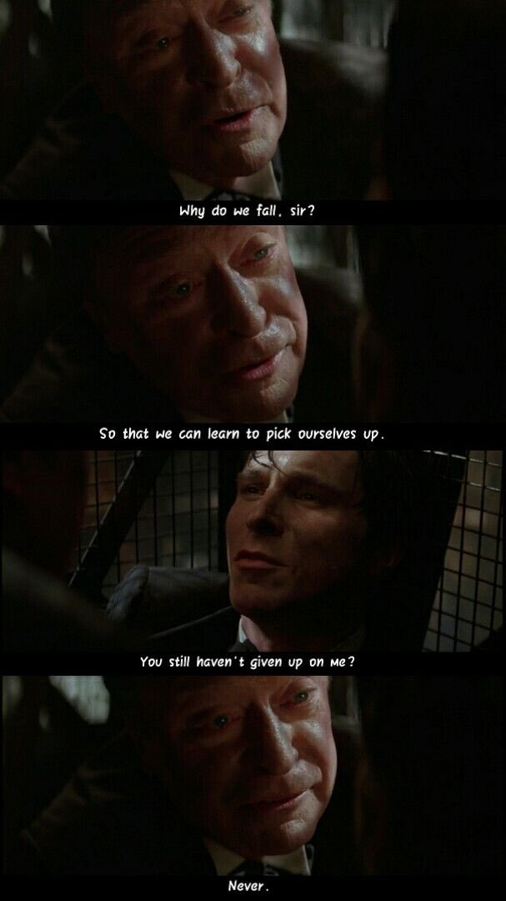

Consequences
Psychological
Social
Health
Anxiety disorder
Moodiness
Depression

Slide 135
End of 9th Chapter
Return to contents

Slide 136


Prohibited list
&
Therapeutic use exceptions (TUEs)
Christopoulou Spyridoula, Chemist, Msc
Scientific Support and Quality office HADA

Slide 137

Prohibited List
sites: https://www.eokan.gr/substances
https://www.wada-ama.org/en/prohibited-list#
Annual review (at least).
Publication on October and enforcement from 1st of January of next year

Slide 138
Enhancement possibility or athletic performance enhancement
Certain or potential threat for the athlete’s health
Violation of clean sport spirit
INCLUSION CRITERIA

Slide 139
Prohibited List
Always prohibited (In and Out of Competition):
Prohibited substances: S0, S1, S2, S3, S4, S5
and
Prohibited methods: M1, M2, M3
Prohibited In-Competition:
S6, S7, S8, S9
Prohibited in specific sports:
P1:b-blockers

Slide 140
Always prohibited (In and Out of Competition)
Prohibited Substances:
Anabolic agents (e.g. testosterone)
Peptide hormones and Human Growth Hormones/Agents (e.g. EPO, Growth Hormone)
Β2-agonists (e.g. asthma drugs)
Hormone and Metabolic Agents (e.g. insulin)
Diuretics and masking agents (e.g. furosemide)
Prohibited methods:
Blood transfusion or blood manipulation
Intravenous infusions in some cases

Slide 141
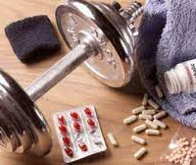
Prohibited In-Competition
Stimulants
(e.g. ephedrine, pseudoephedrine)
Narcotics
(e.g. morphine)
Cannabinoids
(e.g. cannabis)
Glucocorticoids through some specific routes (joint inflammation)

Slide 142
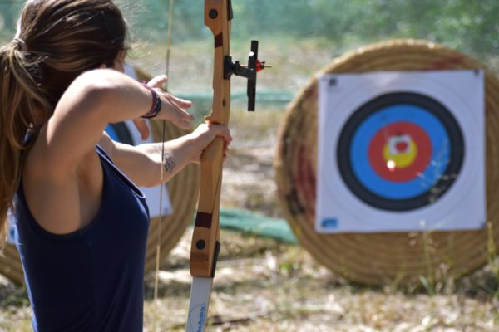
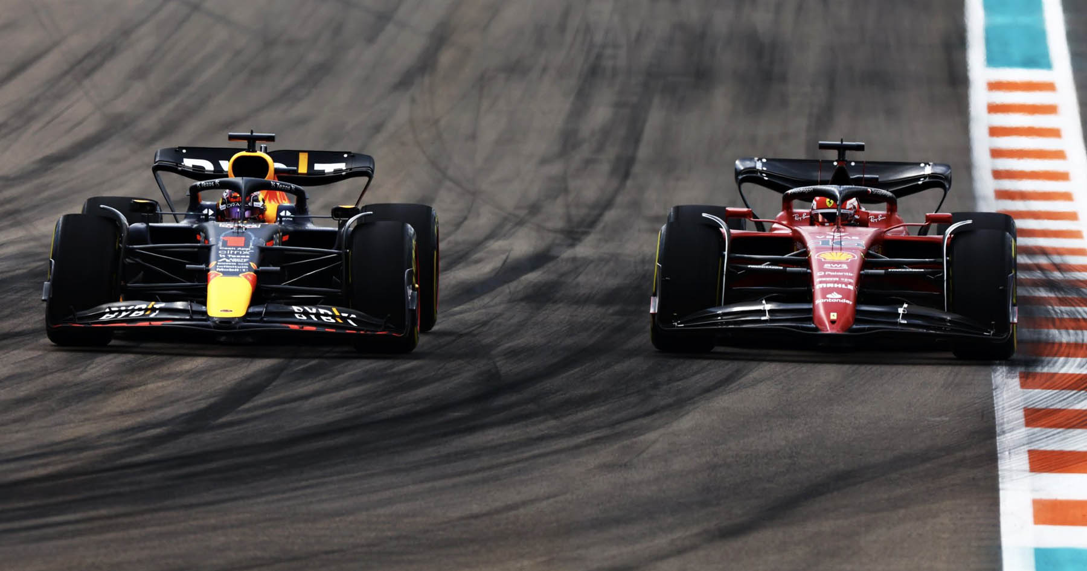
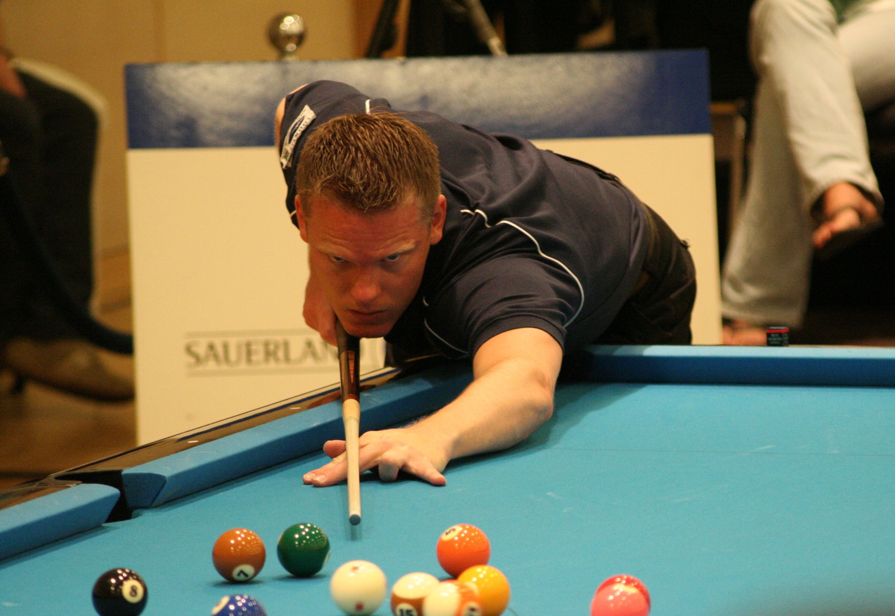
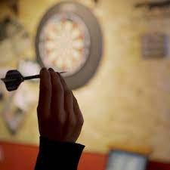

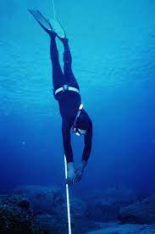
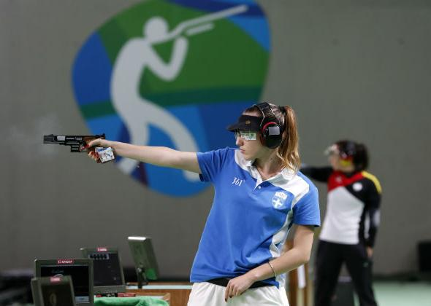
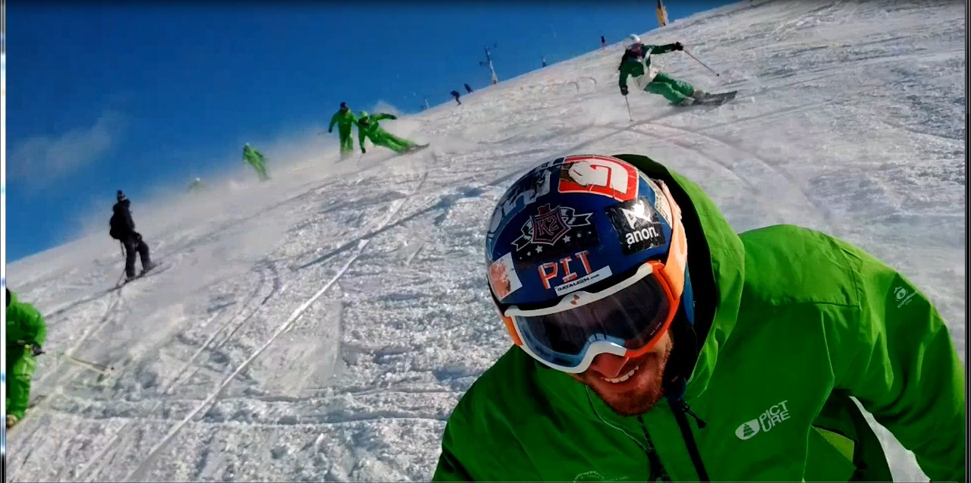
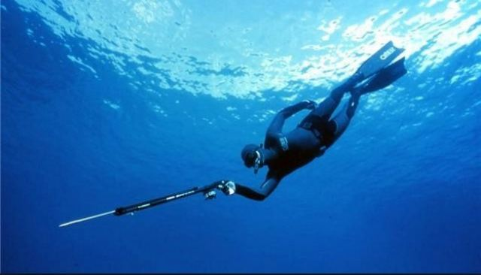
Prohibited in specific sports
B-blockers: Prohibited In-Competition
Απαγορεύονται και εκτός αγώνων
Απαγορεύονται και εκτός αγώνων

Slide 143
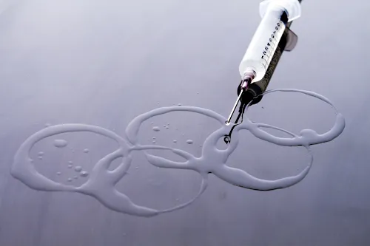
Prohibited Methods (in and out of competition)
Blood manipulation and manipulation of its ingredients
Chemicals and natural manipulations
Gene doping

Slide 144

Tips for correct and safe use of the Prohibited Substances list
Reading the List
Everything mentioned on the list is not a medicine
Not all prohibited medicines are included on the list
Only the medicines ingredients are mentioned and not their brand names
Many natural products are not mentioned
Using the List
Pharmaceutical medication administration route
Male or Female athlete
Permitted doses

Slide 145

Check of pharmaceutical medication
Doctor or pharmacist
Thoroughly documented inquiry to HADA
Research the pharmaceutical products on the website: www.galinos.gr
Research the active substances of the product for each sport on the websit: www.GlobalDro.com

Slide 146

TUEs
sites: https://www.eokan.gr/tue-procedures
https://www.wada-ama.org/en/resources/world-anti-doping- program/international-standard-therapeutic-use-exemptions-istue

Slide 147

Prohibited substance or method due to Therapeutic Use (disease, condition, emergency state)
TUE

Slide 148
WHY?
Ensuring probable TUE due to treatment.
Avoiding sanctions in case of adverse analytical finding (positive doping control).

Slide 149
Who?
National Level Athlete
If your level is lower than “National Level”: retroactive TUE application.

Slide 150
When?
National Level Athlete (RTP): 30 days before game.
National Level Athlete: Adverse Analytical Finding: Retroactive.
Non-National Level Athlete: Adverse Analytical Finding: Retroactive.
TUE from HADA: only on National Level
*In case of International competition, the respective IF must approve it.

Slide 151
HOW?
TUE application: https://eokan.gr/assets/site/docs/TUE%20Application-el_v1_2022.pdf
Complete medical file: medical documents with initial diagnosis (where possible), medical history, exams, lab analysis, απεικονίσεις (scans?).

Slide 152
ΤUE PROCEDURE
Doctor
Athlete
The athlete pays a visit to his doctor and his condition/disease diagnosis requires the use of a product the substance or application method of which is included in the WADA Prohibited List.
Informs the athlete regarding the decision and registers it on ADAMS
TUE application
TUE Administrator HADA
TUE Administrator HADA
The TUE committee decides within a 21 days deadline
TUEC

Slide 153
Administration Criteria TUE
Diagnosed Medical Condition
Unsubstantial performance enhancement from the athlete’s behalf and one the same level as if he were healthy
There is no permitted, reasonable therapeutic alternative
It is not the consequence of a former (without TUE) substance or method use

Slide 154
Health issues which usually requireTUE
Attention Deficit Hyperactivity Disorder (ADHD)
Asthma
Type 1 Diabetes
Intravenous fusions
Inflammatory Bowel Disease (IBD)
https://www.wada-ama.org/en/PhysicianGuidelines

Slide 155
Retroactive TUE
Immediate and urgent treatment
Insufficient time, you did not have the opportunity or emergencies occurred
Adverse Analytical Finding after out of competition substance use, which is prohibited only in competition (e.g. glucocorticoids)
Based on HADA anti-doping rules, you were not allowed or requested to apply for a TUE beforehand
You are a lower than National Level Athlete who does not belong in the jurisdiction of an IF or a NADO and you got submitted in an anti-doping control
In rare and exceptional cases, you may apply for TUE if taking under consideration the Code spirit, it would be unjust not to grant a retroactive TUE
*This unique case of retroactive TUE, will be granted, only after a beforehand WADA approval (it is in WADA’s discretion to approve or deny HADA’s decision)

Slide 156
Therapeutic Medication and Doping Control
Pharmaceutical medication statement (whether it is prohibited or not)
TUE Administration or not
Copy of approved TUE

Slide 157
FAQ
May I assist my athletes with their whereabouts?
I am a coach/trainer, and I am not submitted to a doping control. Should I learn about Results Management?
Yes! Remind them to submit their documents before due date and encourage them to update their whereabouts if necessary.
Yes! You should be aware and fully comprehend the procedure of Results Management. Even though you are not submitted to a doping control, there is a possibility to face sanctions for other transgressions, such as trafficking or possessing prohibited substances.

Slide 158
End of 10th Chapter
Return to contents

Slide 159

Intelligence & Investigation

Slide 160



WADA AND Ι&Ι OFFICE
Code: The latest edition (2021) of the WADA Code mentions that each Antidoping Organization shall have the capability to conduct investigations and collect, evaluate and manage antidoping intelligence (Article 5.7)
International Standard of Testing and Investigations (ISTI)
Information collection policies: HADA’s policies ensure that all inntelligence gathered is confidential and it is exclusively accessible by authorized personnel, complying with the designated procedures of the Code and the International Standards.

Slide 161


The unseen antidoping heroes are those who provide ADRV related information to the Authorities (Witold Bańka, 2022) President World Anti-Doping Agency (WADA).
In a two-year timeframe the ADRV related information led to the resolution of 400 cases (Günter Younger, 2018) Director of Intelligence and Investigations World Anti-Doping Agency (WADA).

Slide 162


I&I
Collects, researches, evaluates information, cooperates and acts (ISTI)
Information sources: Information platform (Speak with no fear), by telephone, open sources, collaborating agencies, athlete’s whereabouts, intraorganizational collaboration (between departments/offices).
Agencies of interest: Athletic community, Sports Federations, NADOs, Legal authorities (Police, Sports Prosecutor), Pharmaceutical services, Public.

Slide 163

Why is I&I important?
It has a definitive role in elaborating and implementing an effective strategic antidoping plan.
It strives for catching all ADR violators.
Protects the right of everyone to compete under equal terms and by the absence of prohibited substances and methods.

Slide 164




Confidentiality
Privacy Anonymity
Its imperative for the Organization and the I&I office that there is mutual trust between them and those who are willing to disclose information.
Why should someone share information?
  Protects him/herself
  Protects sports in general and especially the sport he/she represents
  He/she becomes an ally in the antidoping battle and to the protection of those who want to compete under the same terms.
  To establish this trusting bond between the Organization and those who want to disclose information, HADA guarantees:
  The preservation of anonymity
  The privacy of the disclosed information
  The privacy of personal data of those who wish to disclose their personal data.
  Information management policies and its adjustment by exclusively authorized personnel!!!
  Protection of personal data
  Legislation for public interest witnesses

Slide 165
Kinds of Intel
Use or Possession of prohibited substances by athletes or ASP
Sell or Buy of prohibited substances.
Transportation routes of prohibited substances.
Trafficking and delivering networks of prohibited substances.
Any information regarding any insinuation of ADRV (Article 2 Code WADA)

Slide 166

Collection means of anonymous or eponymous intelligence
E-mail address: intelligence@eokan.gr
Platform «Speak Up Without Fear»
By post office on the address: OAKA Olympic Complex-Indoor Swimming Pool - Gate D - Sp. Loui
Kifisia's 37 Av., Marousi, 151 23, Greece
Verbally or by sending a message: 6972279788
Verbally with authorized personnel member

Slide 167


Slide 168


Slide 169
End of 11th Chapter
Return to contents

Slide 170

Values and ethics in sports
Case studies

Slide 171

Sports Ethics
There are some written and unwritten rules which we must respect and abide by.
Written rules and WADA Code form the regulatory context of sports
Example of non-written rules:
In case of an injury in a football match, the opposing team stops the play or kicks the ball out of the sidelines so that the doctor can treat the injured player. After the injured athlete gets out of the field o play, the possession of the ball returns to the opposing team which displayed respect and fair play
If a team does not use its last offense when up by an adequate margin to seal the win
In layman’s terms, whatever feels right, even if it goes against the desired outcome (victory), is a fair play
It is much more important and fruitful for an athlete’s career to behave and act on what feels right inside of him, rather than letting his behavior adjust on small and meaningless things such as the score of game. Same thing applies to life in general.

Slide 172

Sports ethics’ effect on character
The values of sports become understandable
There is an already existing and under constant formation a background of values and ethics
Personal values and sports values get harmonized. Whilst they interact with each other, they concurrently enhance our ethical “being”.

Slide 173

Sports values
Self-respect
Respect everyone/be a team player (teamwork + work ethic)
Empathy (get into the shoes of others)
Fairness (respecting the rules)
Sports values align with life values
The ethics norm was shaped by what the majority of people considered as ethical
There is not only black or white. There is grey as well, however not in the case of prohibited substances.
Fair Play

Slide 174
Intact/doubtable code of values
Carrying an injured opponent till the finishing line of a marathon
Not competing with all my powers
Match fixing
Depriving my opponent’s right to compete fairly against me (e.g. using prohibited substances)

Slide 175
High level athlete with substantial performances in his sport and awards on National level asserts that he was very careful substances intake.
His/her point of view on prohibited substances use was crystal clear.
«There is no need for extras to achieve high performance».
«Training, balanced nutrition and appropriate recovery are adequate to be a high-level athlete».
He/she followed specific training program, eluded alcohol, followed the ASP’s instructions to the letter and was particularly carful with his nutritional plan.
Case Study 1

Slide 176
There was an adverse analytical finding in an In-Competition doping control.
He/she could not explain how the prohibited substance was found into his body and delivered an analytical list of the dietary supplements he was using.
There was an imported supplement ordered online on that list.
A sample of the supplement was chemically analyzed, and it proved the existence of the prohibited substance.
The prohibited substance was found in the supplement, but it was not included in the label of the supplement.
As a result, the athlete committed an ADRV without his knowledge.

Slide 177
Questions
Is it the athlete’s fault he/she used a prohibited substance?
Is the trainer/coach and ASP responsible for the athlete’s ADRV?
What could the athlete have done to avoid the ADRV?
Yes. The athlete is completely responsible for whichever marker, metabolite or prohibited substance is found in his body, whether the use was intentional or not. That is the strict liability principle.
No. However, if an administration or possession of an ASP related ADRV gets proved, then they will get sanctioned according to the Code and the legislative regime.
Every athlete who uses dietary supplements cannot be entirely certain for its (clarity)/purity, especially when it is purchased online

Slide 178
Case Study 2
Two athletes of single sports meet in the locker room after training.
Athlete “A” holds a vial containing a prohibited substance which he accidentally drops on the feet of athlete “B”.
Athlete “B” clearly distinguishes from the packaging the prohibited substance and asks athlete “A” about it.
Athlete “A” reassures him that it is destined for a friend of his and that he does not use it and only carries it to show it to the team’s doctor.
Athlete “B” thought that Athlete “A”’s excuse was sketchy, and he became suspicious. They were competing on the same category and were both claiming medal positions. Therefore, Athlete “B” deposited a written eponymous report (indictment) regarding the incident to HADA.

Slide 179
Questions
Are there any sanction for athlete “A”?
If athlete “A” proves that the prohibited substance was intended for a friend of his who is not an athlete, is the possession permitted?;
Was athlete “B” right to come forward and make the report (indictment)?
Yes! Possession of prohibited substance constitutes an ADRV, which means he will get sanctioned.
The athlete will get sanctioned even if he proves that the substance was intended for someone else.
Athlete “B” was right to report athlete “A”. By doing so, he protected the clean sport spirit and kept justice and equality between all athletes who want to compete under the same terms intact.

Slide 180
An athlete gets notified after his training that he has been selected for an out of competition doping control.
However, he says that he was not informed beforehand and that he has an important doctor appointment, hence he should leave.
He then refuses to sign the notification form and departs without getting tested.
Case Study 3

Slide 181
Questions
Are there any sanctions for the athlete?
May the athlete choose to get submitted in a doping control on a day that facilitates better his schedule?
Should the athlete have been informed before the doping control in order to change his doctor appointment?
Yes! Refusing to submit yourself in a doping control constitutes an ADRV, which means a sanction will be enforced in such case. Since he was verbally notified, the athlete was obligated to get doping controlled.
No! There is no such accommodations when it comes to doping controls. Refusing or evading a doping control is a serious ADRV and the sanction is as severe as in the use of prohibited substances.
Out of competition doping controls are always conducted without prior notification, therefore the athlete’s allegations are out of place, and he will get sanctioned.

Slide 182
Case Study 4
An athlete has been using dietary supplements for years.
Simultaneously, he has been using a substance, which recent researches proved to enhance the athletic performance, for the past two years.
The substance got included in a WADA research program which proved that it should be inducted to Prohibited List.
The new Prohibited List gets public every October but comes into force on January 1st of the new year.

Slide 183
Questions
May the athlete use it up to 1st January of the next year?
Is there any chance for older urine/blood samples to get retroactively retested for prohibited substances?
Can the athlete apply for TUE so that he can use the prohibited substance?
The use of some prohibited substances may be proved many months later as they tend to linger in our body for a long time till their presence fades. A doping control may prove the existence of a prohibited substance, a marker or its metabolites long after its use took place.
There is a chance, yes! When the tracking/analyzing methods -the Labs employ-, improve or alter, older samples may be reexamined. If in such case, a retroactive ADRV comes up, the athlete will get sanctioned accordingly.
Each athlete using a dietary supplement cannot be certain for its components, especially when the supplement is bought online.

Slide 184
ΣΕΝΑΡΙΟ 5
Case Study 5
An athlete appears symptoms of respiratory allergy and gets urgently transported to the hospital.
A pharmaceutical medication is administered to him in the hospital, which contains a prohibited substance.
The athlete is about to compete to the Greek Championship in less than a week, and he is expecting both a great performance and a doping control.

Slide 185
How should he move forward?
Do nothing. There is a chance he will not get tested.
Decide to not participate to the event
He should contact HADA and get informed about what he should do.

Slide 186
Case Study 6
An athlete gets injured during a difficult exercise in training.
His trainer recommends him a prohibited substance which shortens the recovery period, because the season commences soon.

Slide 187
Should the athlete take the substance and not doubt his trainer?
If the athlete uses the substance and gets submitted in a doping control, is he responsible?
Can the athlete report (indict) his trainer?
The athlete is the main responsible for himself. In such case, he should defy his trainer and unequivocally deny the use of the prohibited substance.
Every athlete is responsible for any substance found in his body. He will be sanctioned for using the prohibited substance regardless from the fact his trainer recommended it to him or not.
Of course, he can, and he should! Furthermore, in case the athlete is a minor, the trainer will face more severe consequences.
Questions

Slide 188
End of 12th Chapter
Return to contents

Slide 189

Thank you for your attention!

